Slide 1

SQL Saturday 918
Charlotte, NC
December 7, 2019
10:30am - 11:20am
Hiram Fleitas
Download: bit.ly/CLT918

Slide 2
SQL Saturday 918
The Game Changer
Hiram Fleitas
Download: bit.ly/CLT918

Slide 3
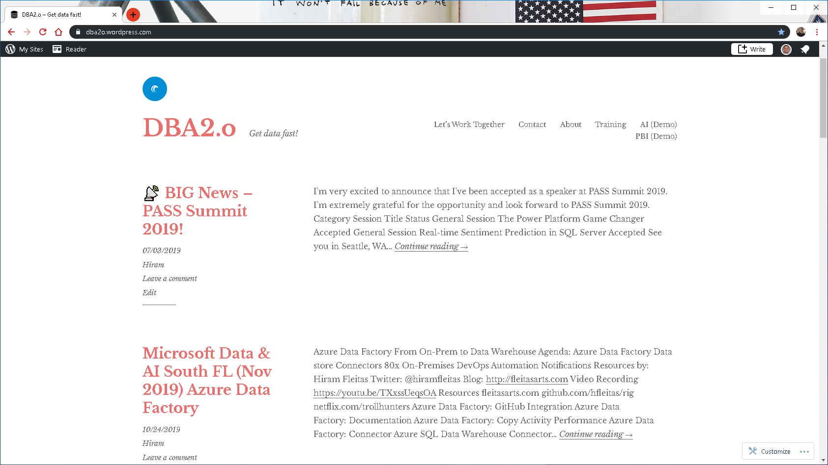

Slide 4
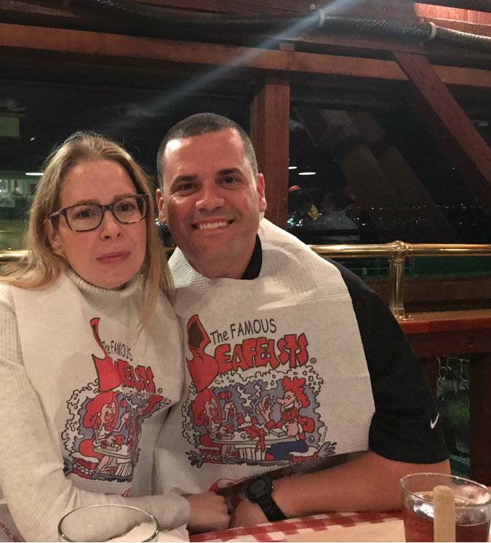

Link to Eval:
bit.ly/CLT918
Your participation is very important.

Slide 5











Hiram Fleitas
Owner, Fleitas Arts
Bio
Father
Developer since 1995
SQL Server since 1999
Fleitas Arts, LLC since 2008
USCG Auxiliary Flotilla Staff Officer
@hiramfleitas
/hfleitas
hiram@fleitasarts.com
hiramfleitas
fleitasarts.com

Slide 6
Demos
Azure Data Studio Notebook
PowerApps
Microsoft Flow
Data Gateway
Siri
Publish & Share Security

Slide 7
Demos
Ai Builder (Forms)
Row-Level-Security (RLS)
Approvals
ISS HTTP Web API
Power Virtual Agents

Slide 8
Azure Data Studio Notebook
one

Slide 9
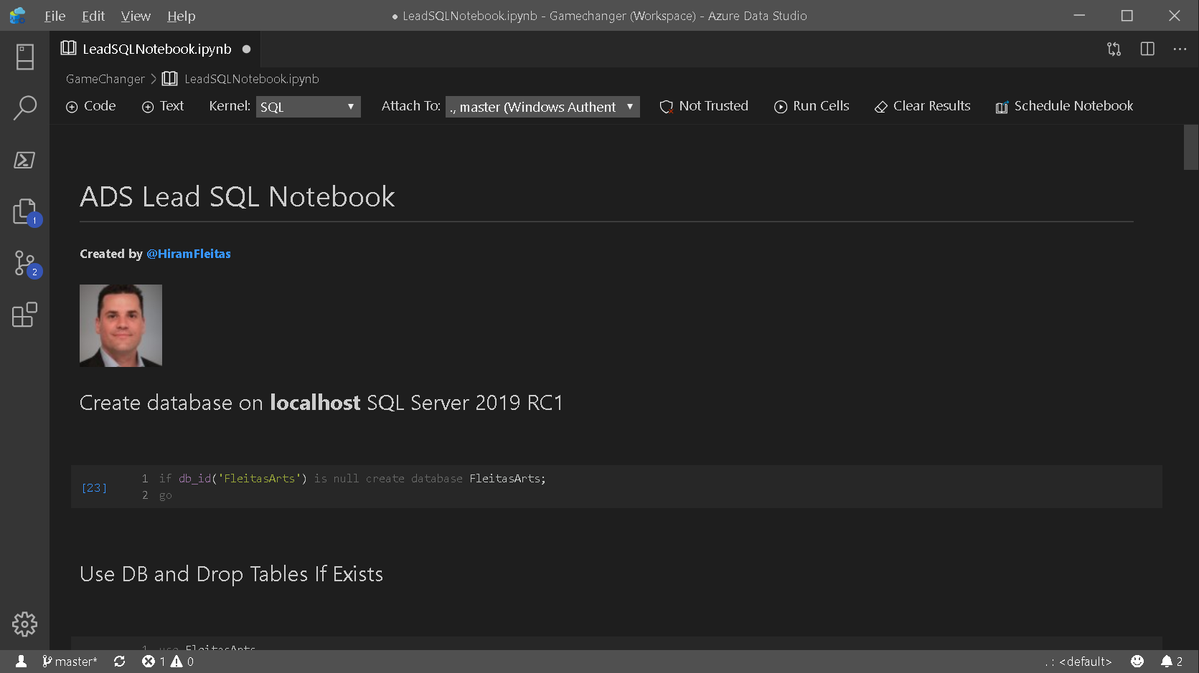

Slide 10
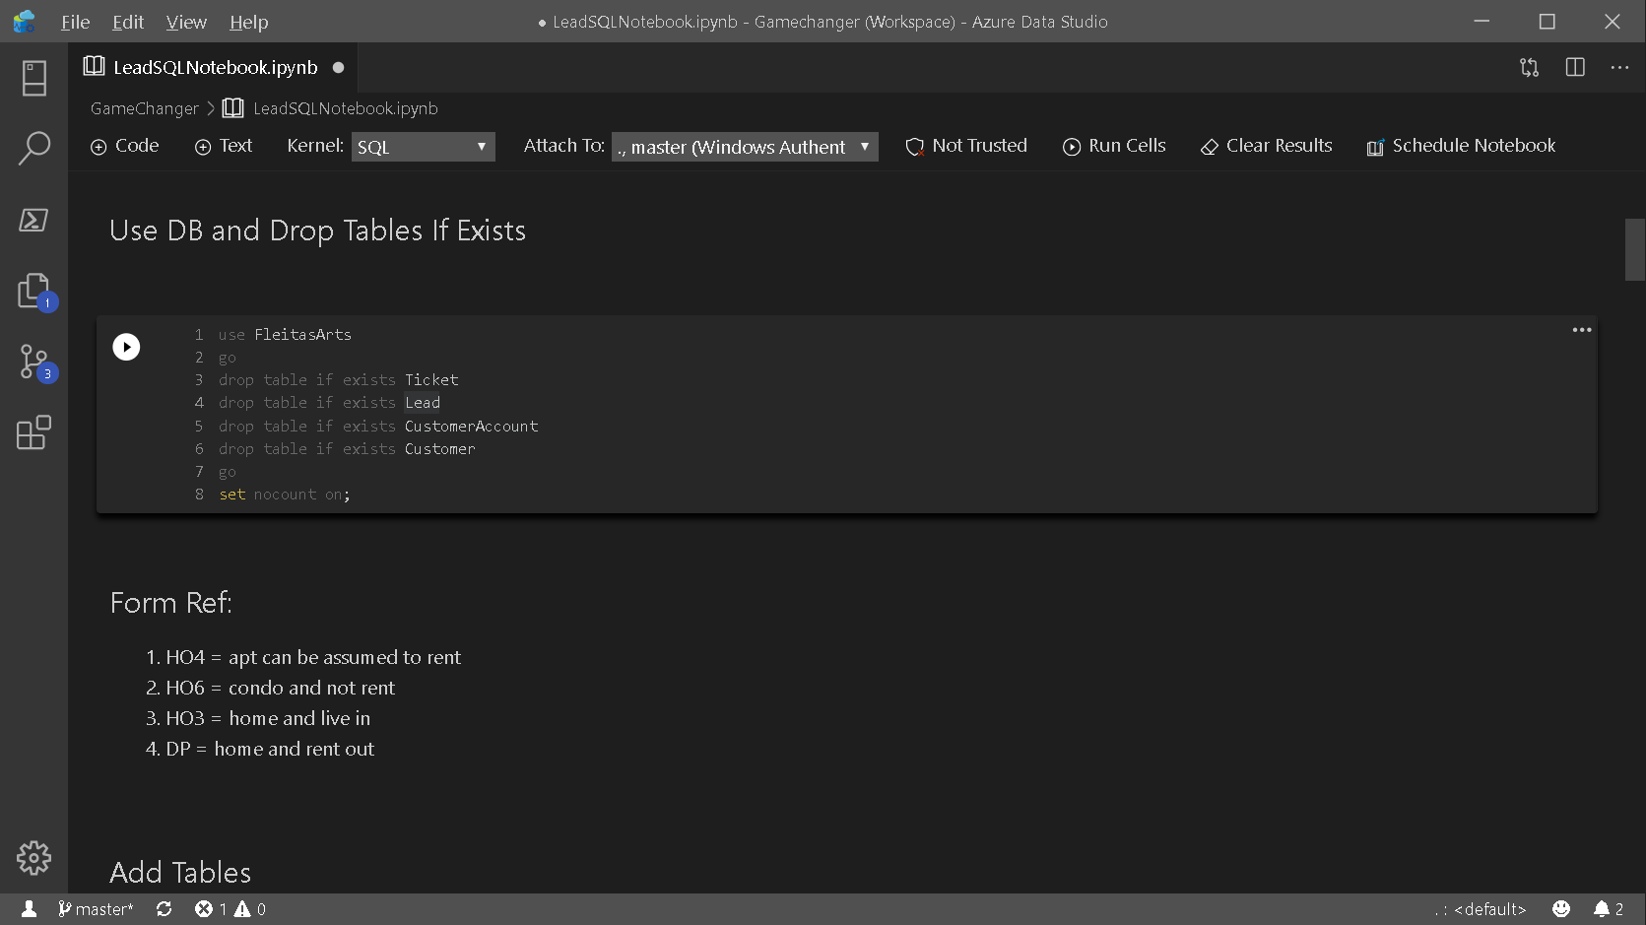

Slide 11
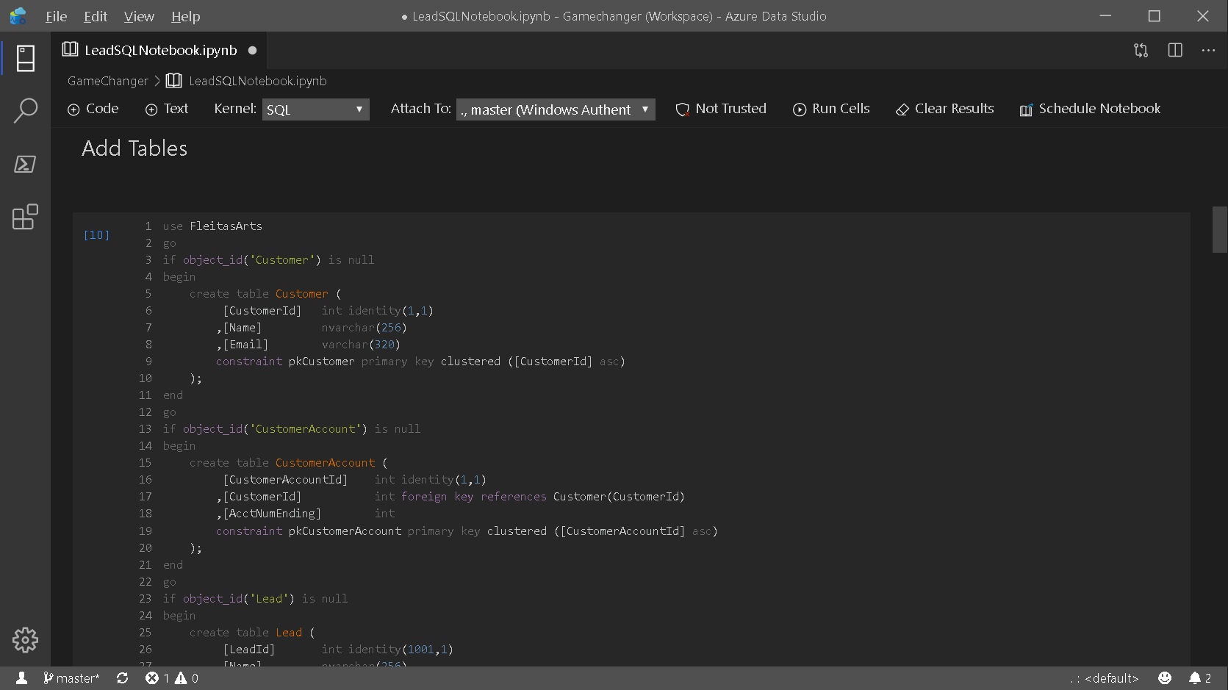

Slide 12
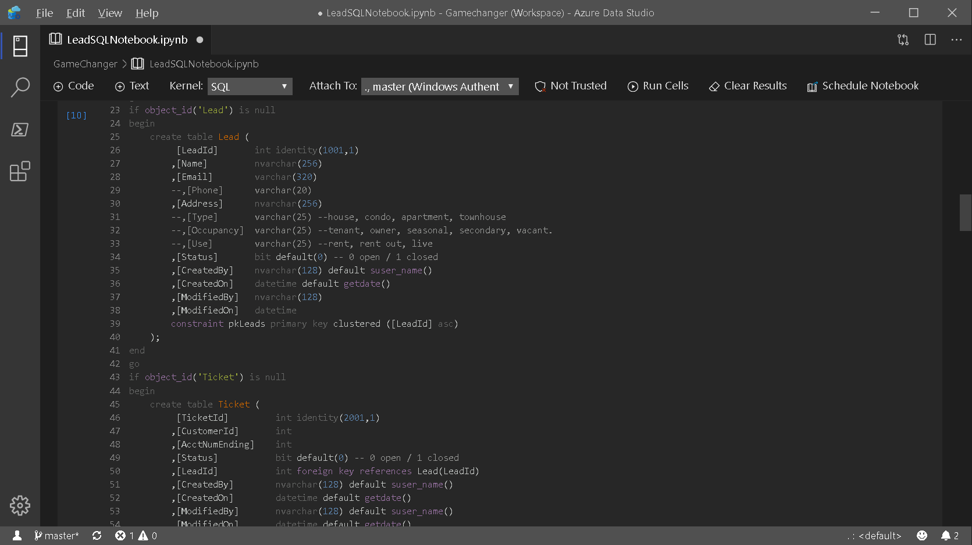

Slide 13
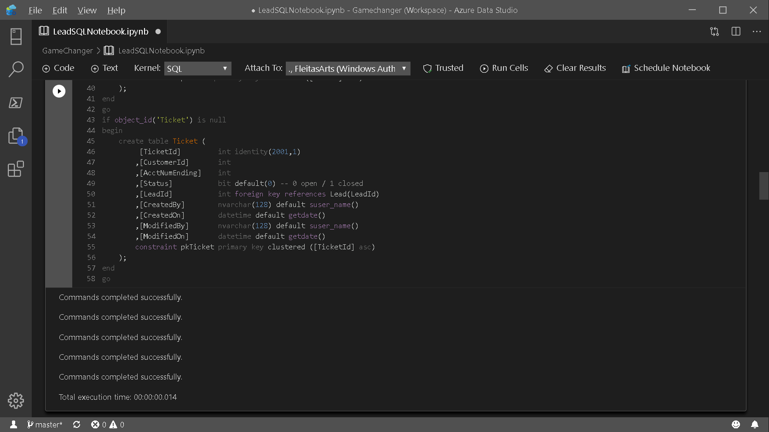

Slide 14
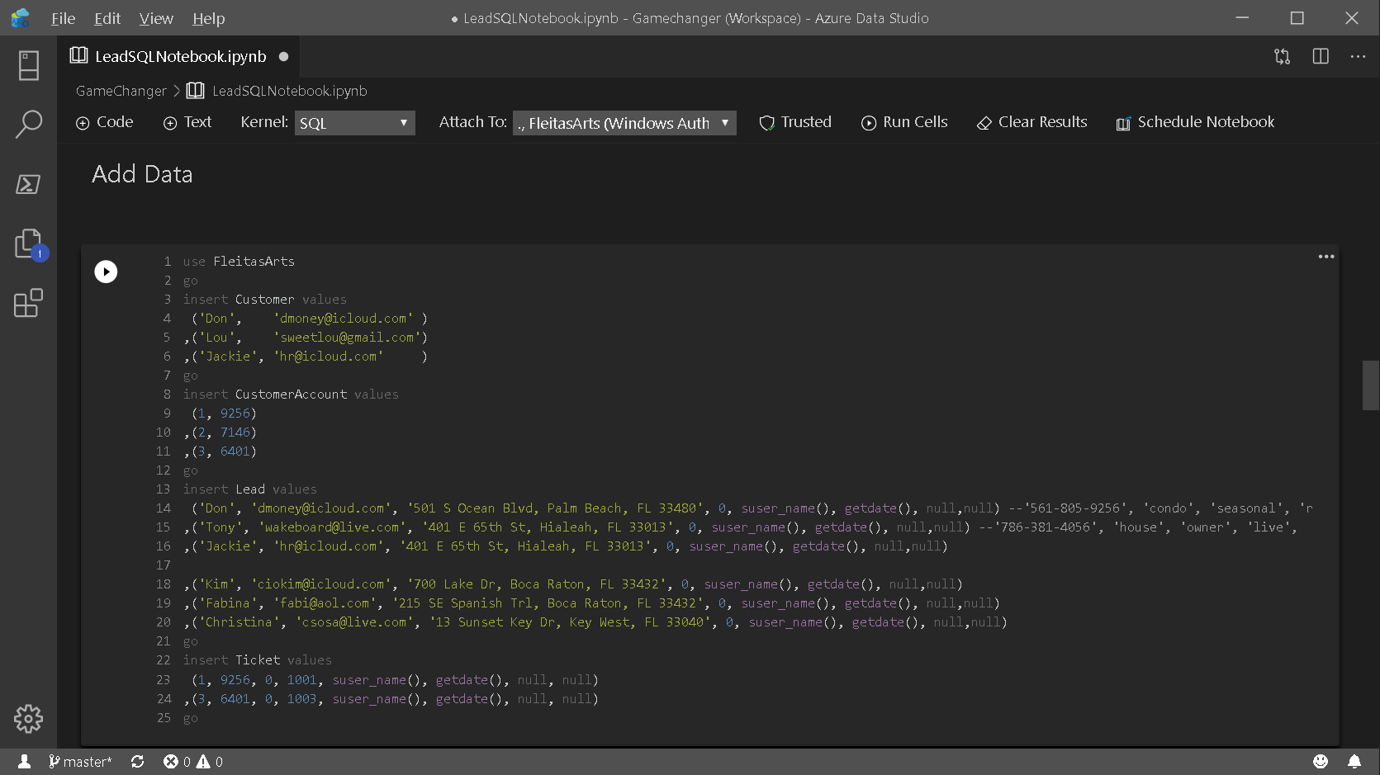

Slide 15
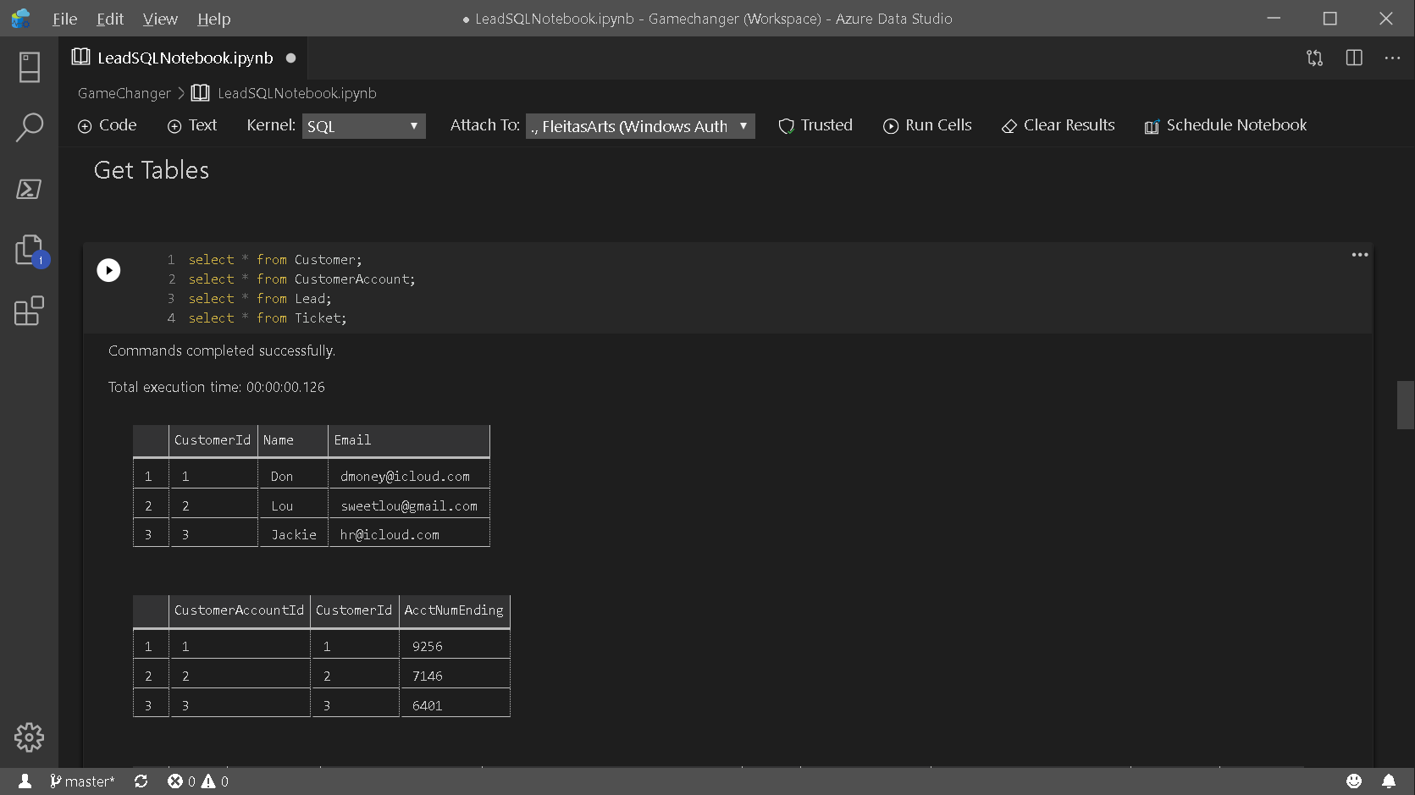

Slide 16
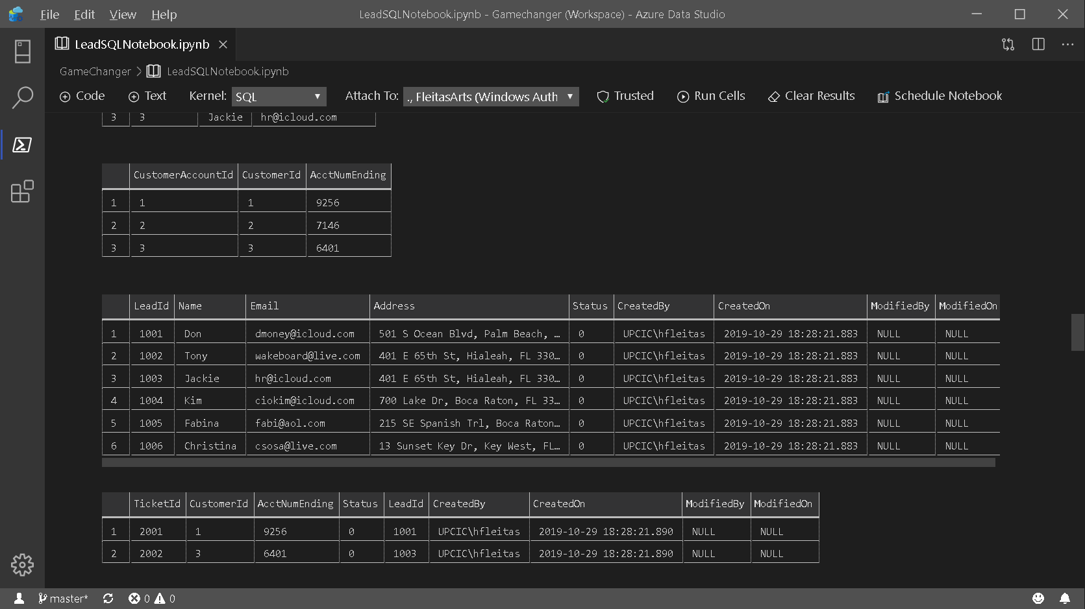

Slide 17
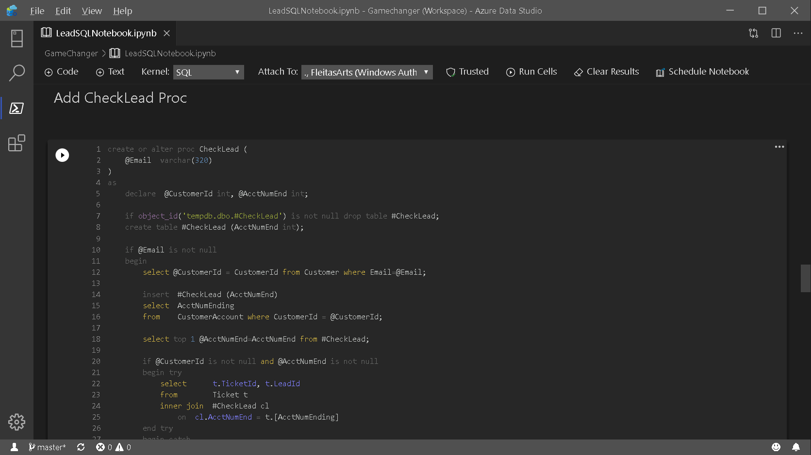

Slide 18
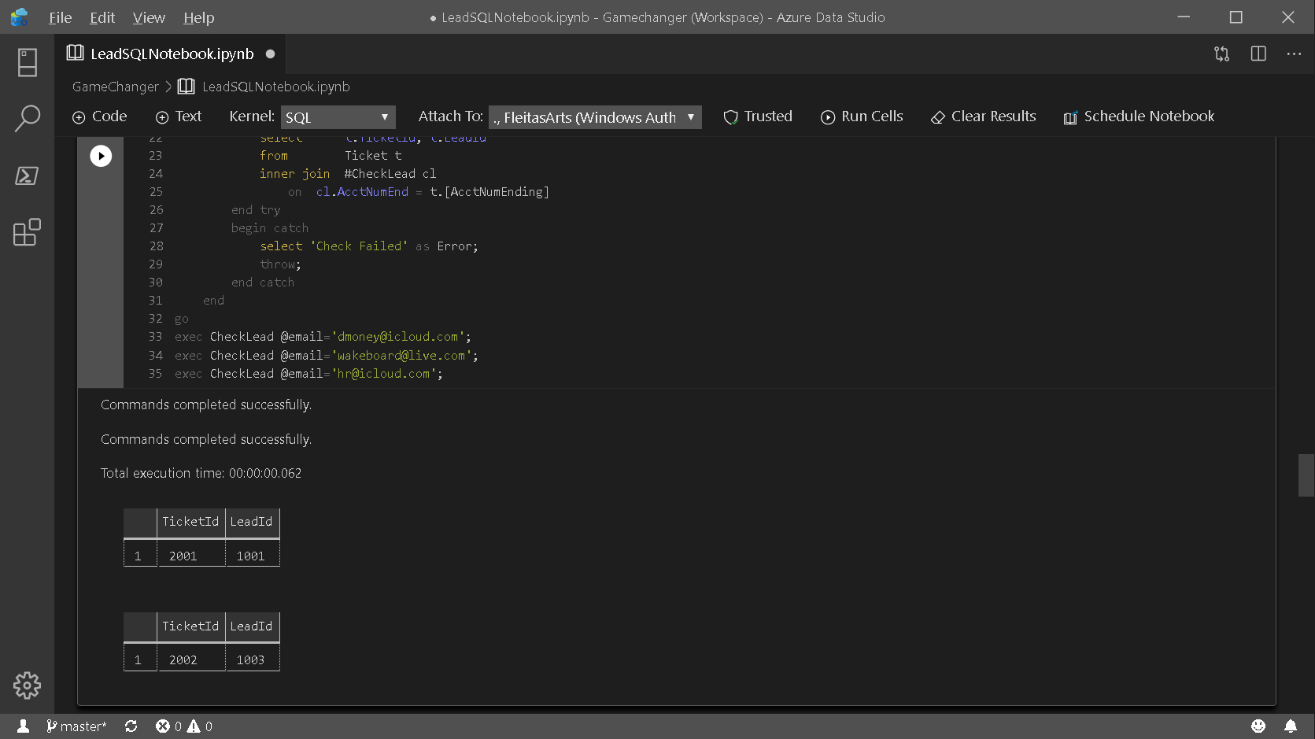

Slide 19
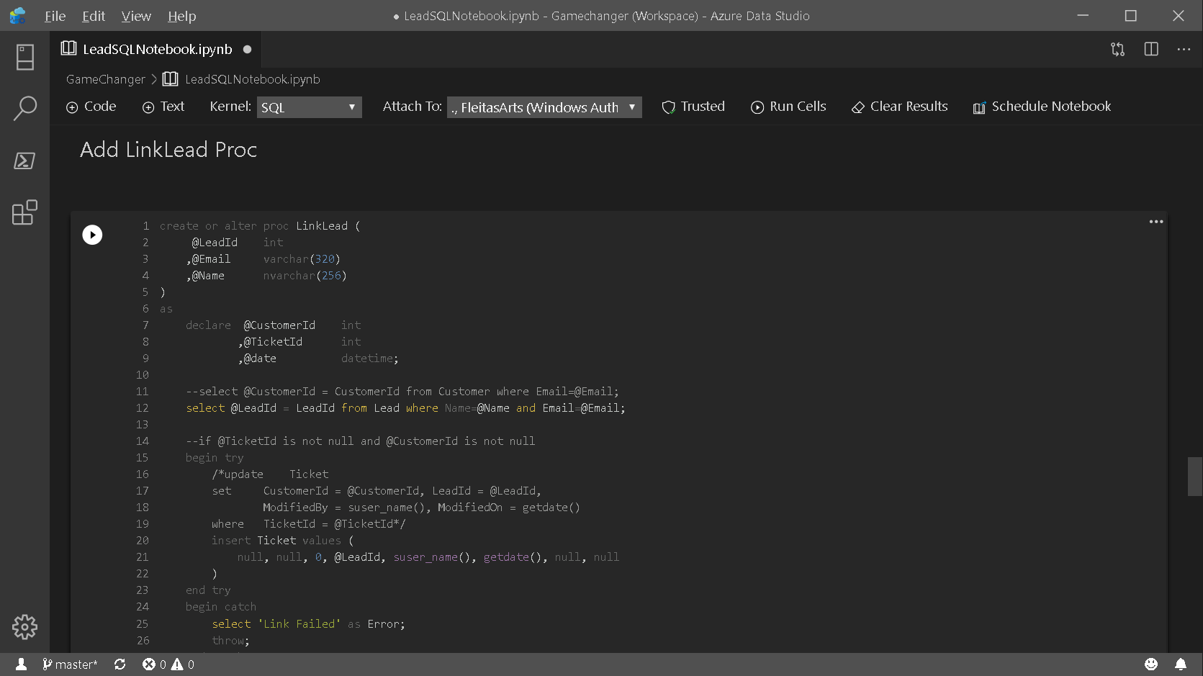

Slide 20
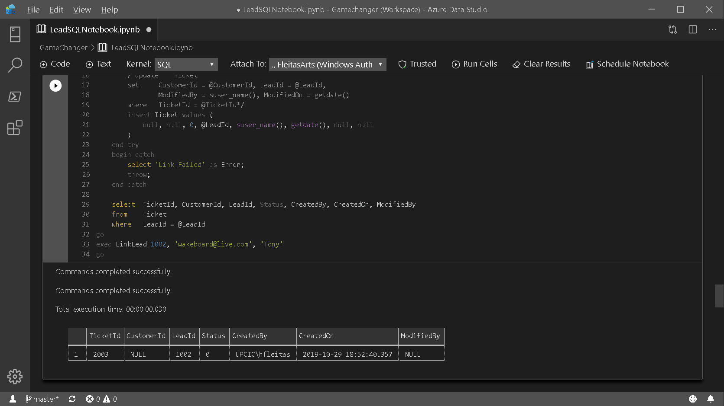

Slide 21
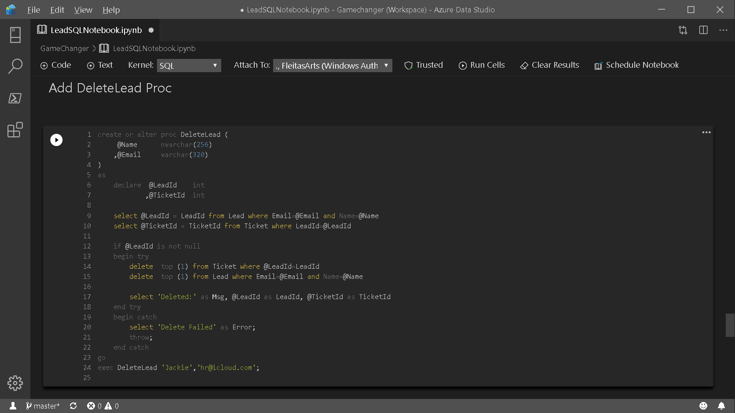

Slide 22
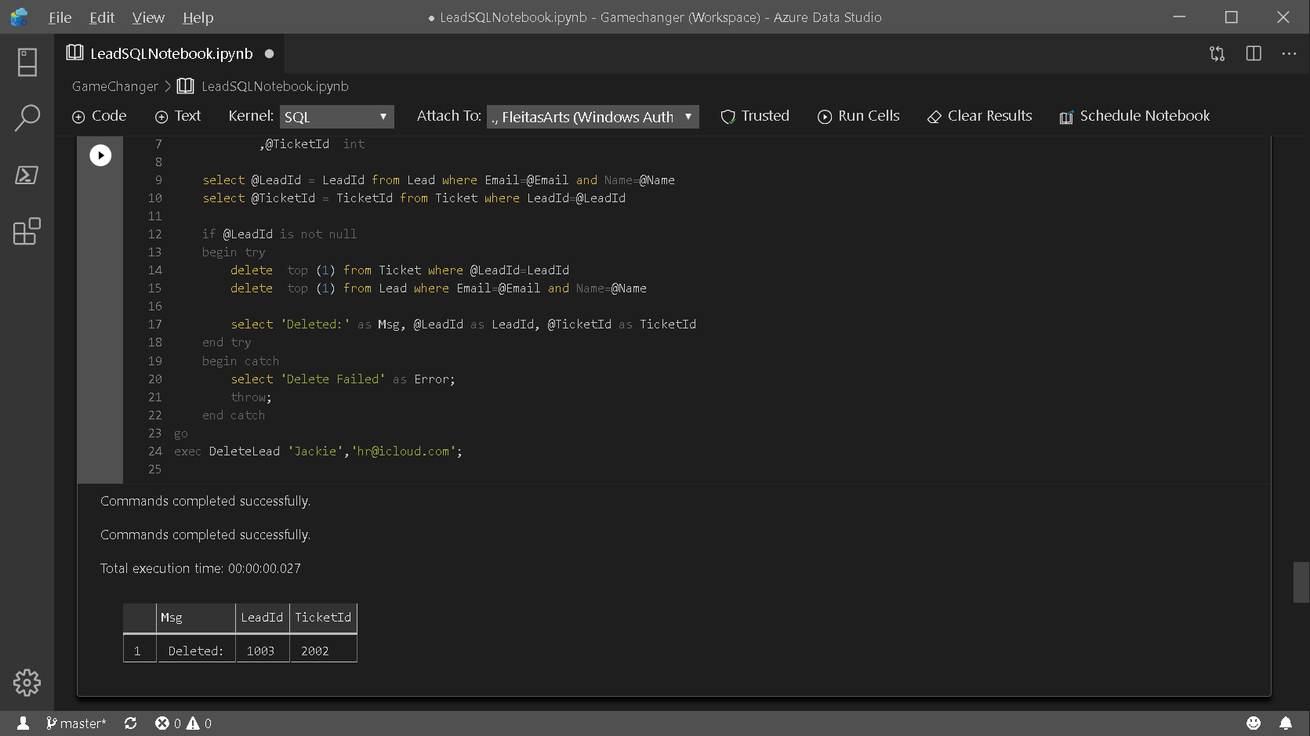

Slide 23
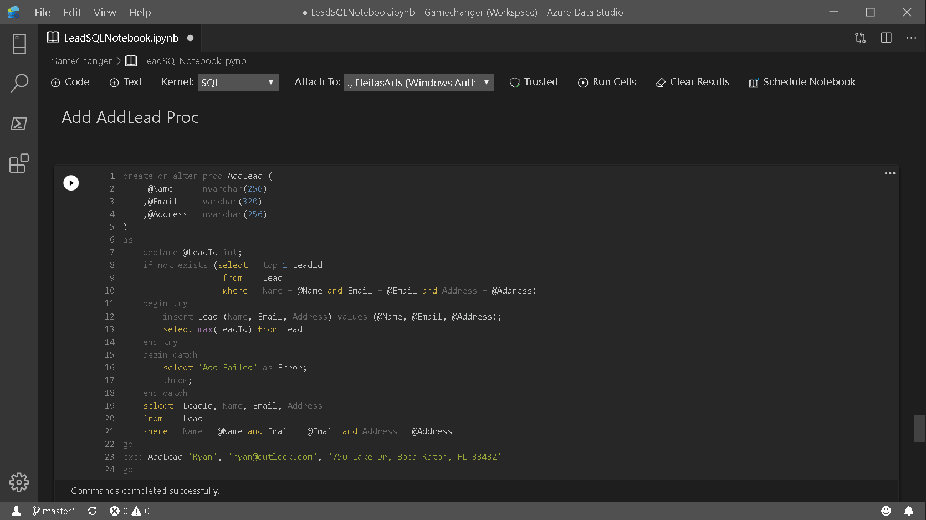

Slide 24
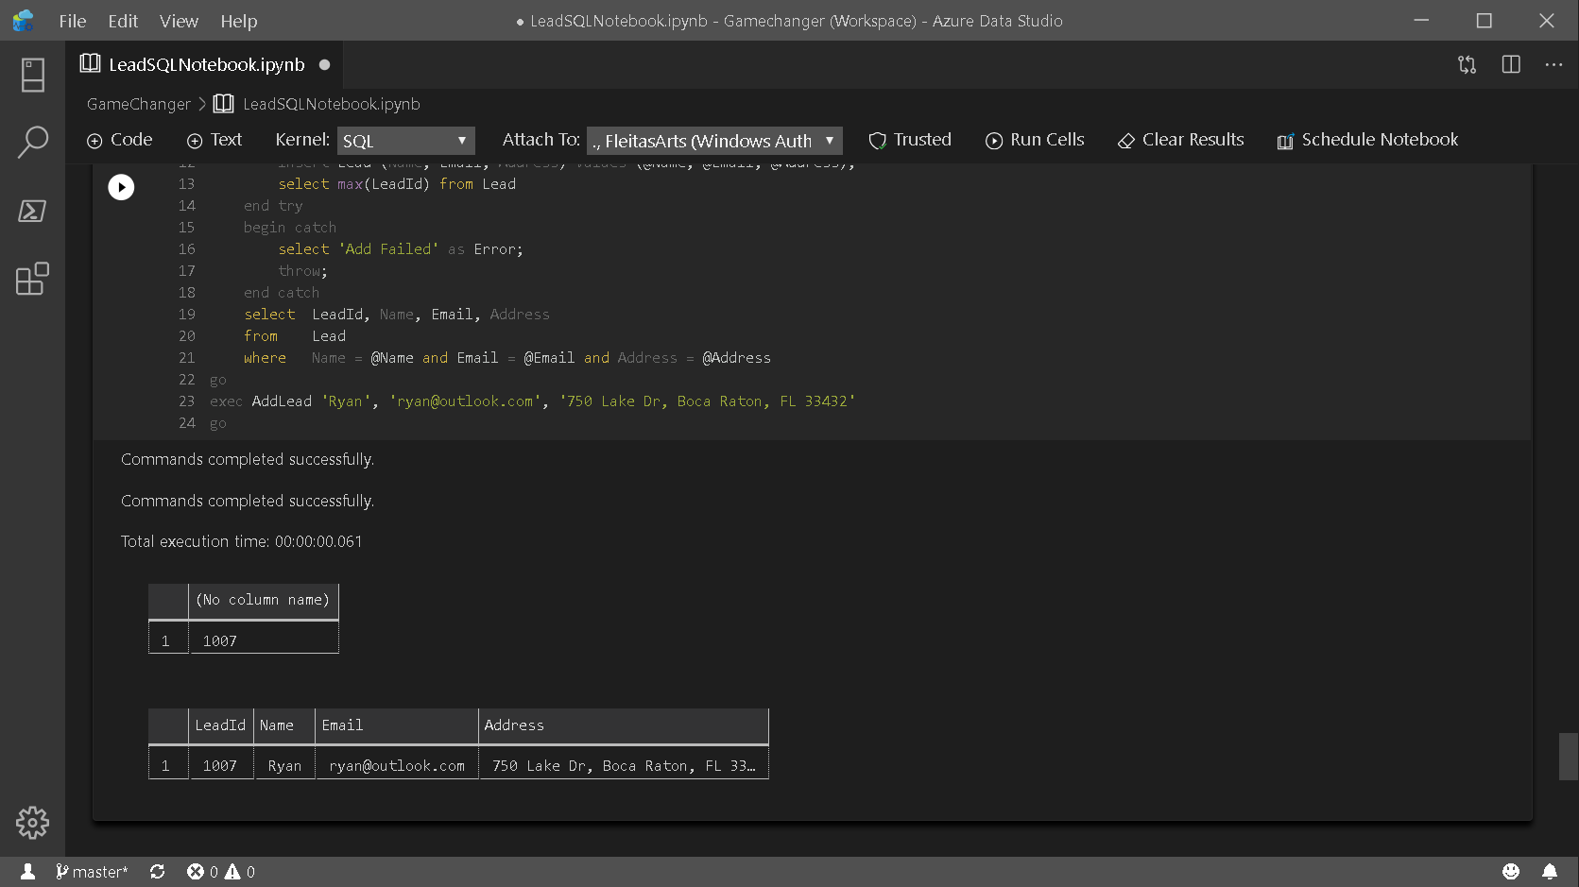

Slide 25
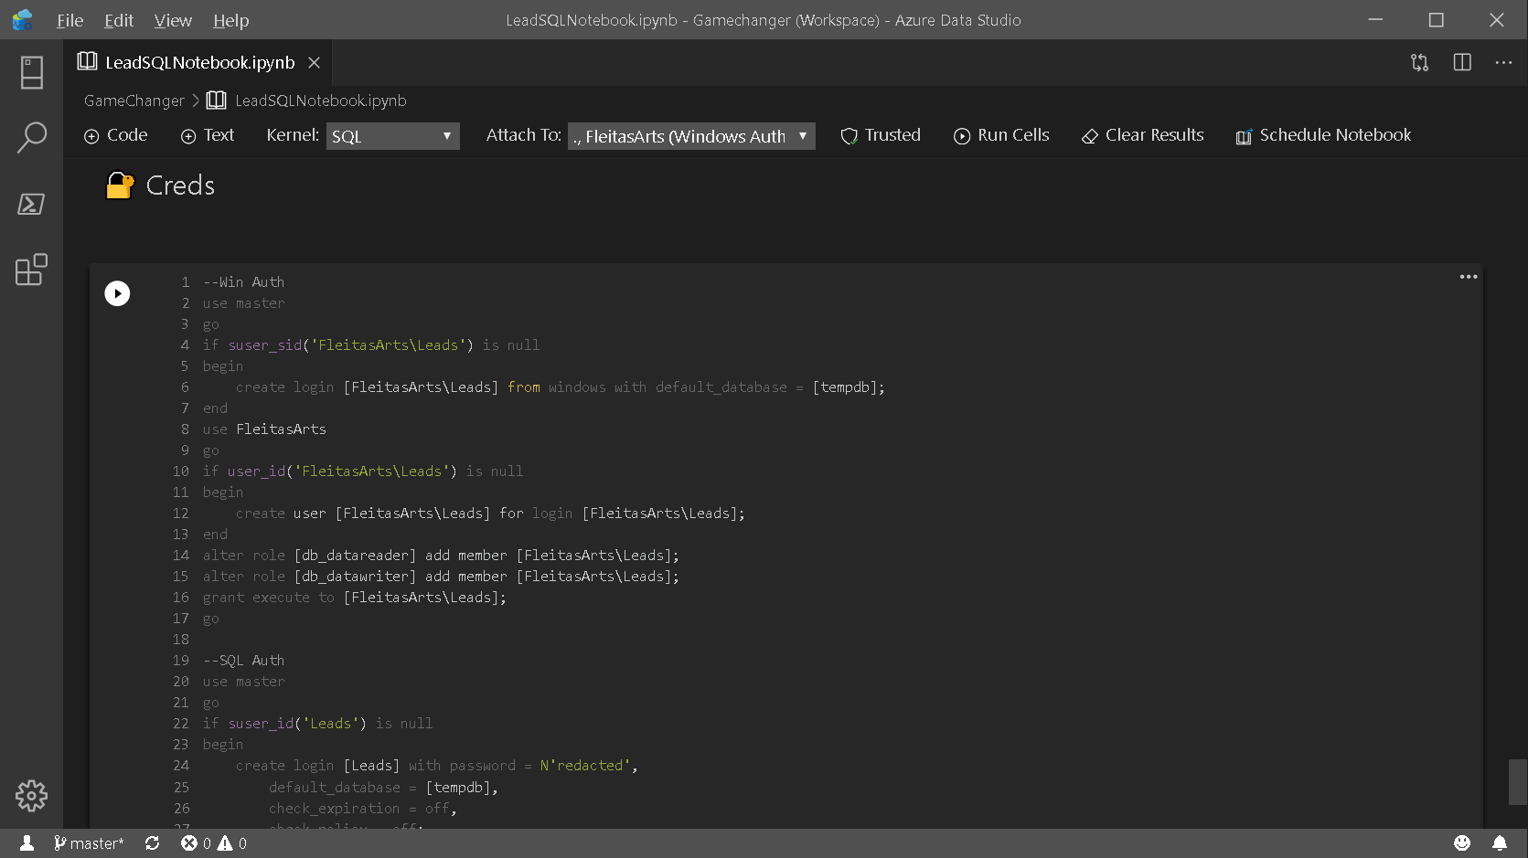

Slide 26
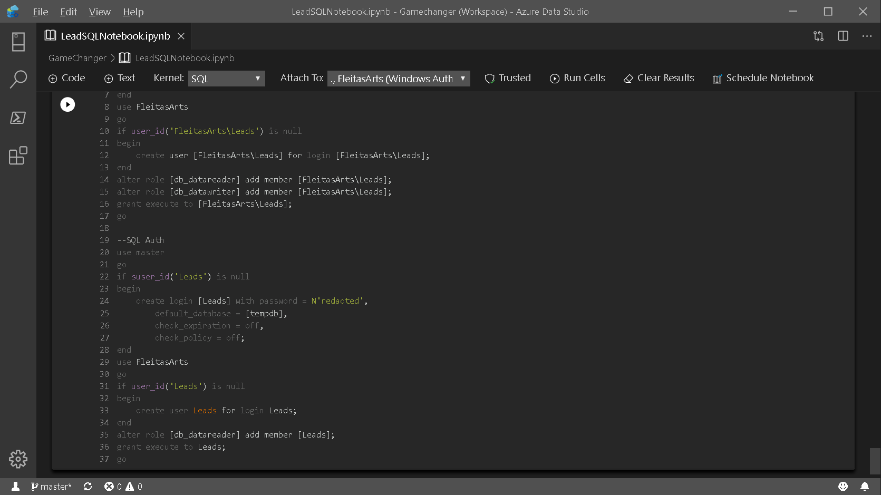

Slide 27
PowerApps
two

Slide 28
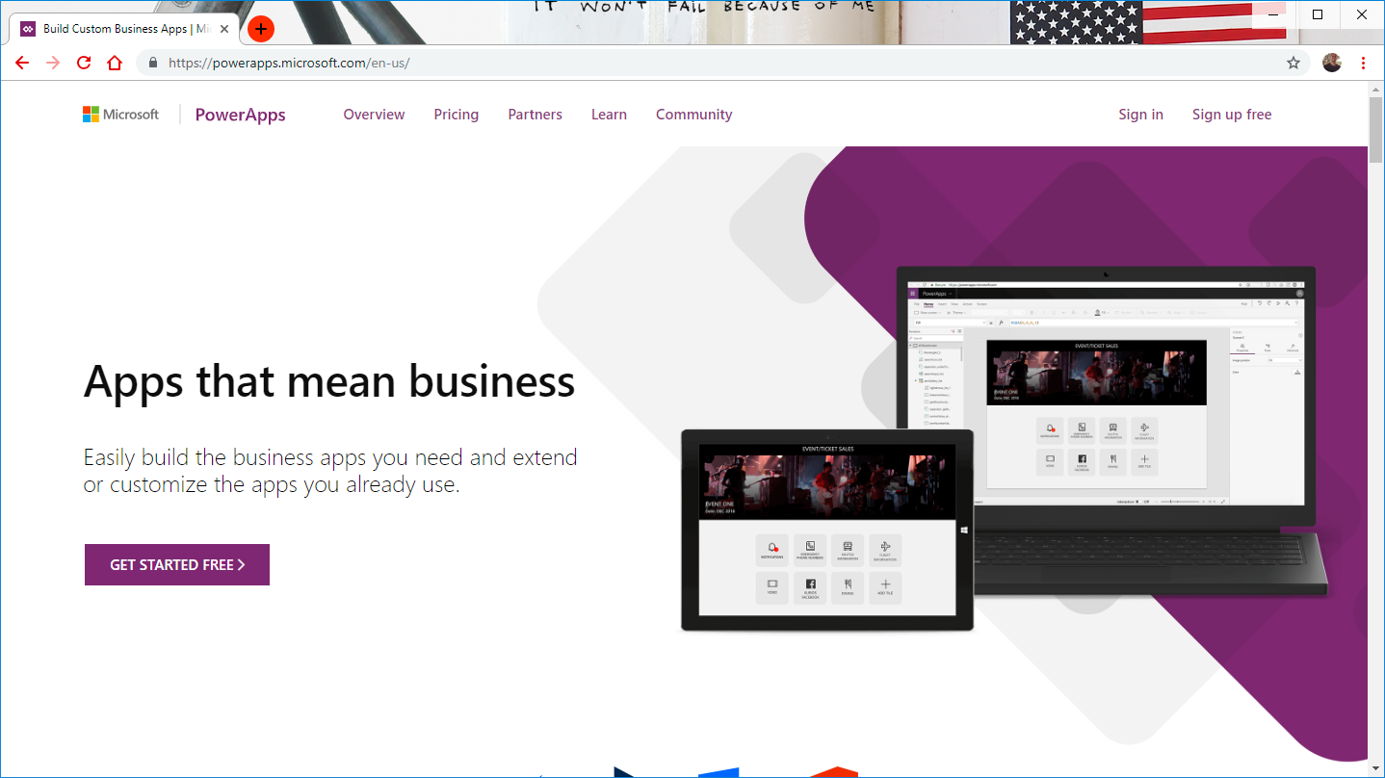

Notes:
Goto: http://powerapps.com, Sign In.

Slide 29
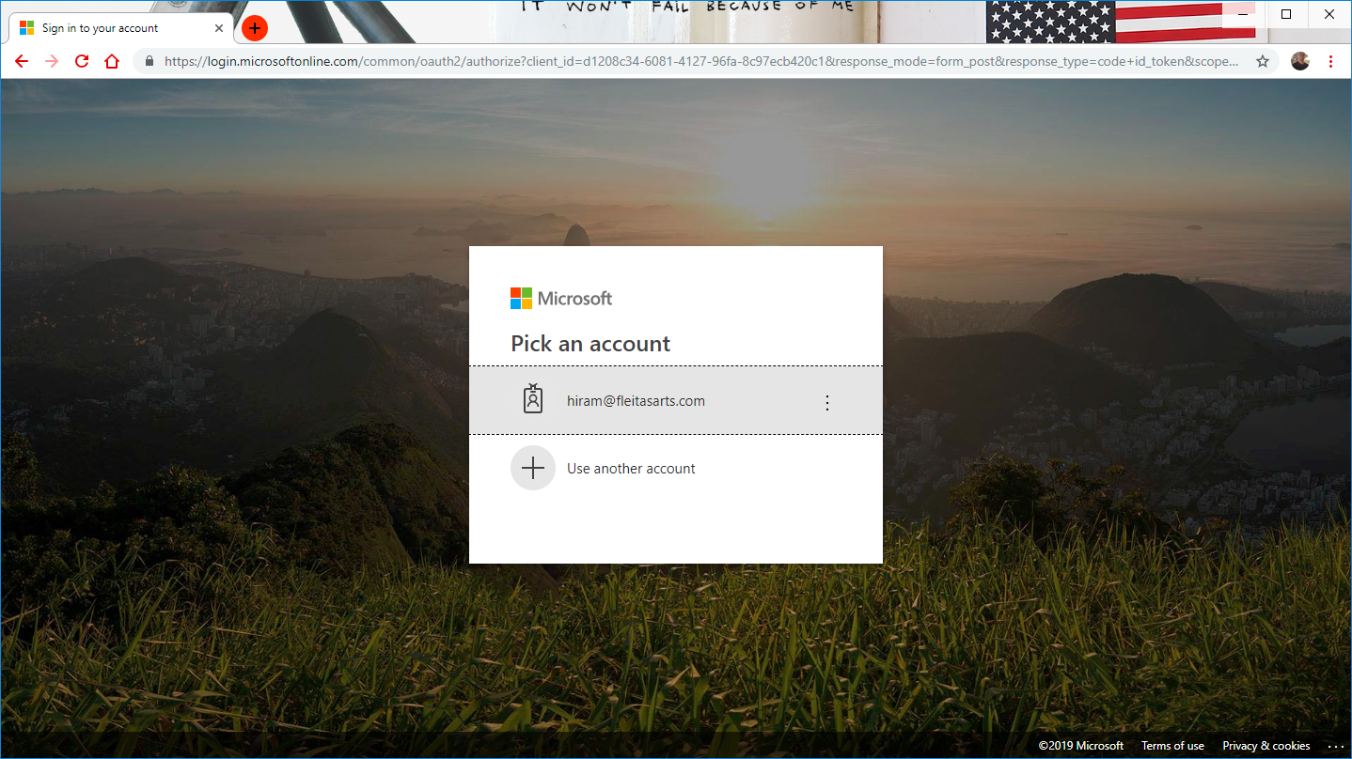
Notes:
Login: http://web.powerapps.com

Slide 30
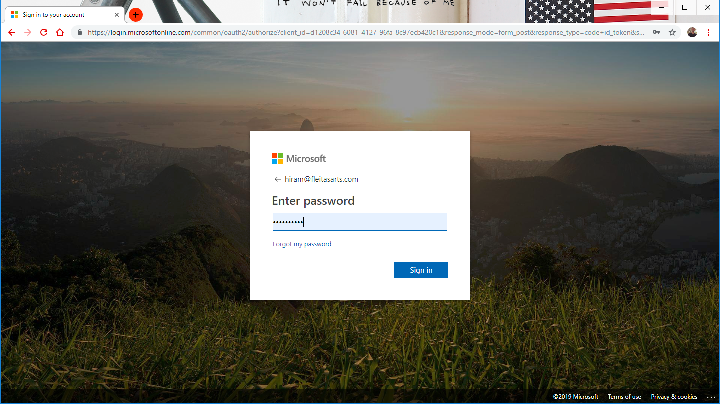
Notes:
Login: http://web.powerapps.com

Slide 31
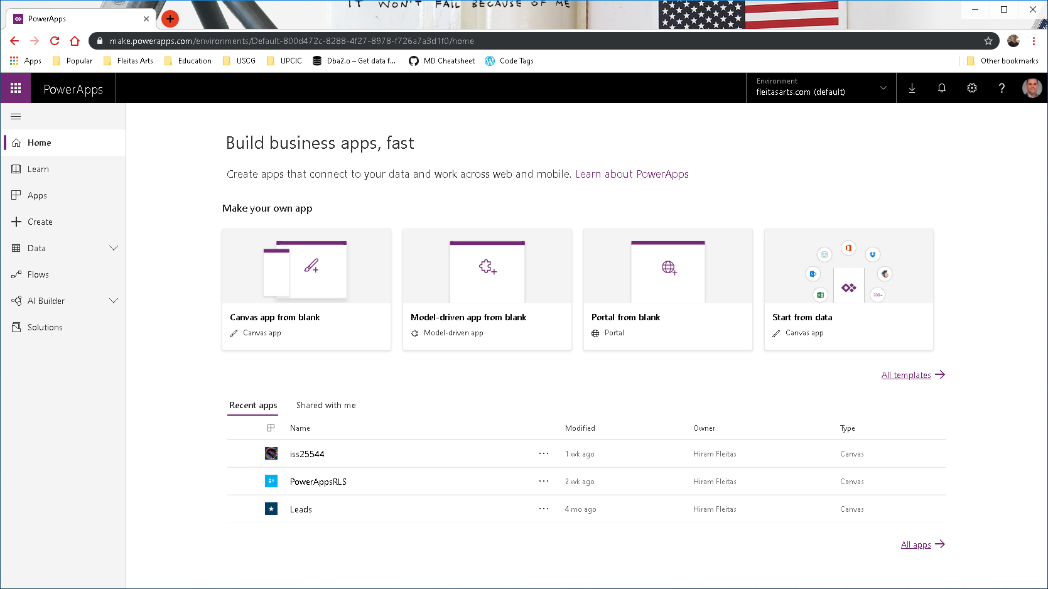

Slide 32
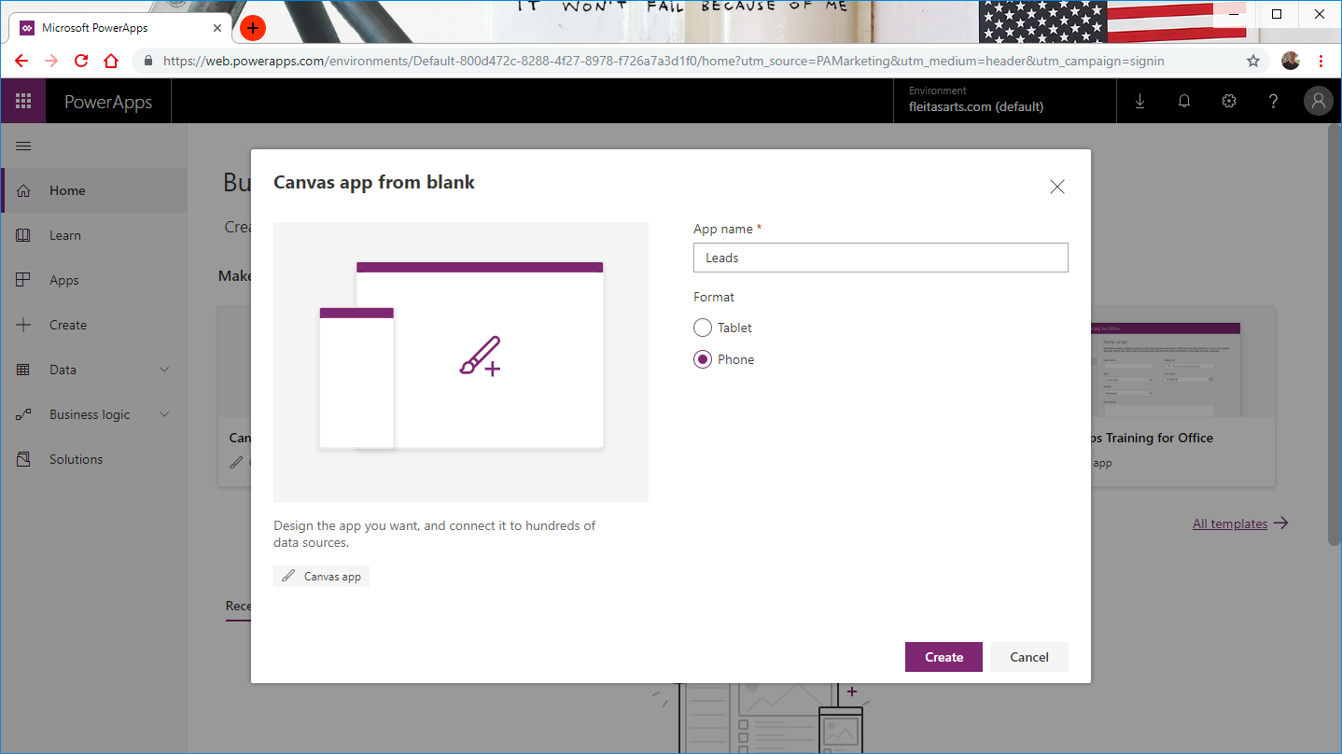

Slide 33
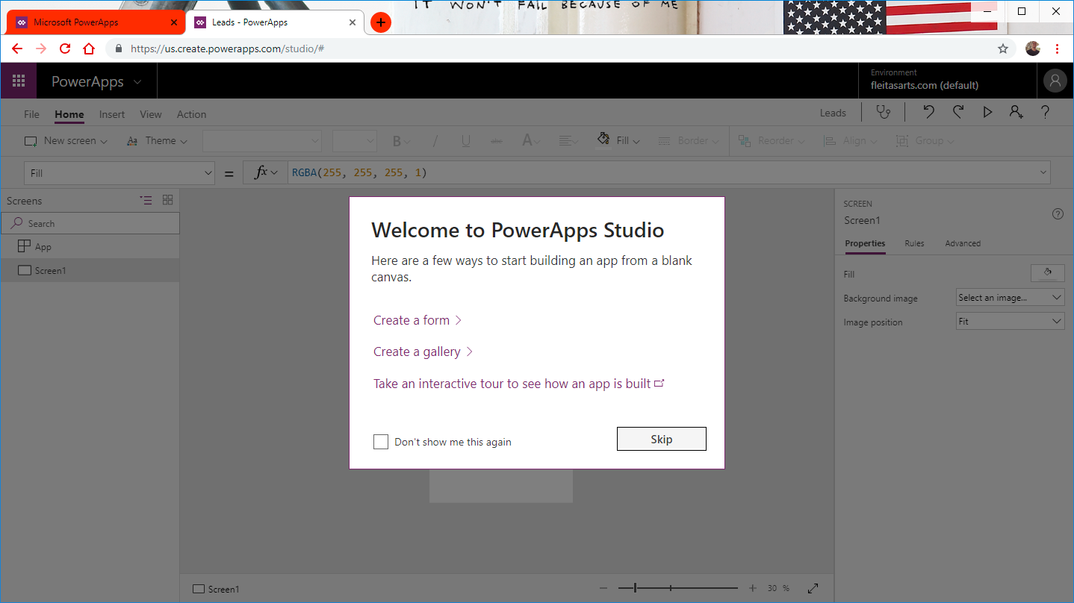

Slide 34
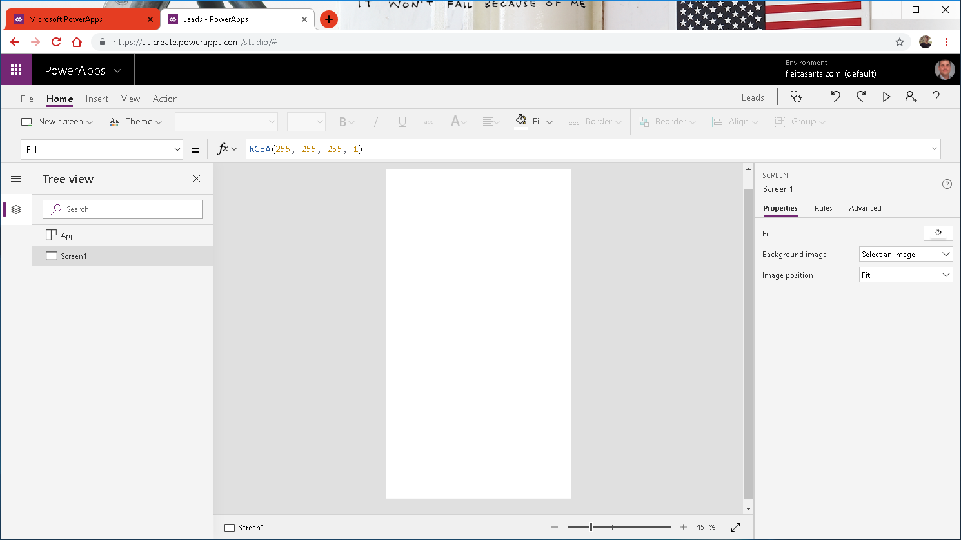

Slide 35
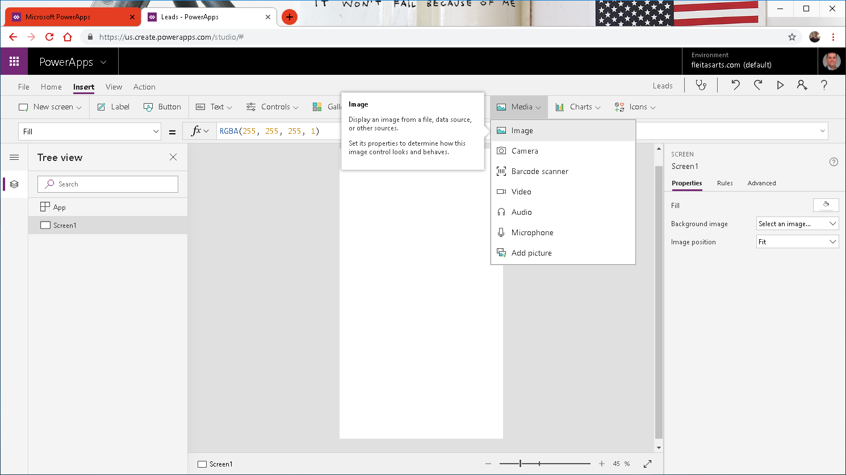

Slide 36
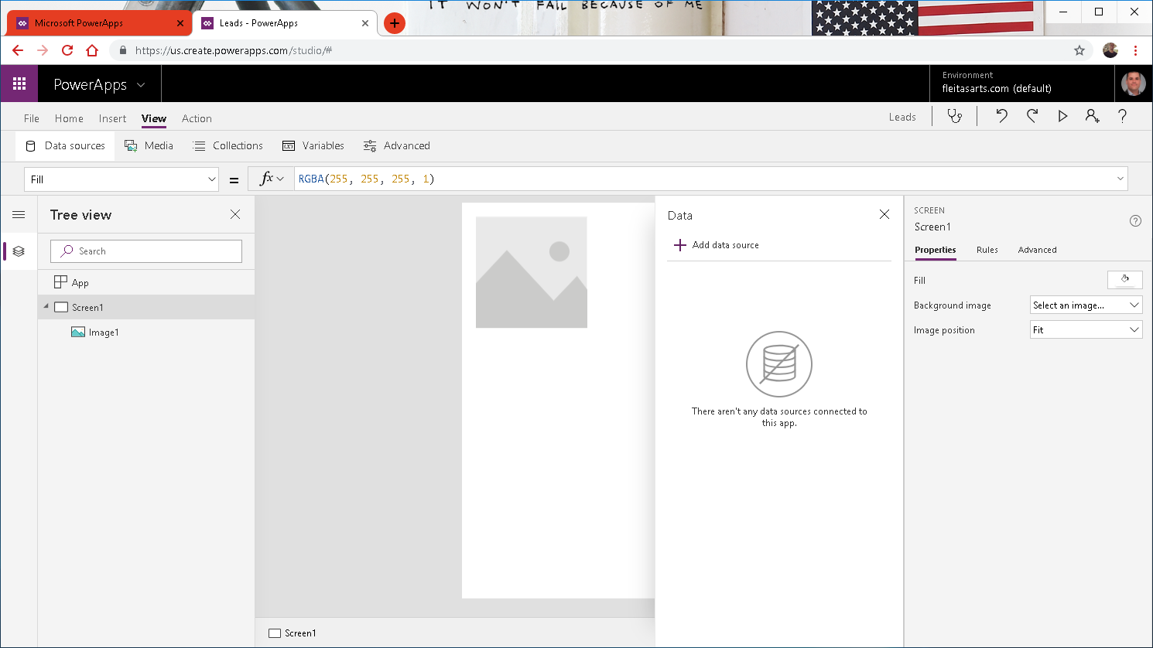

Slide 37
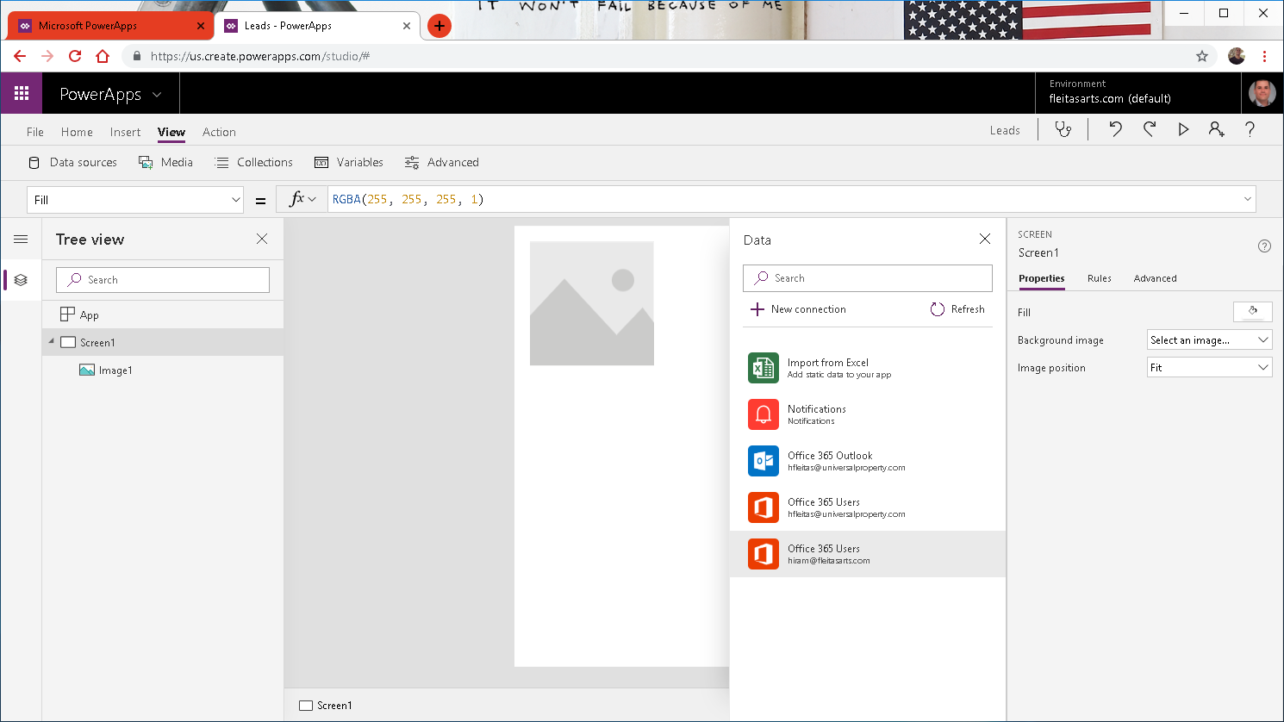

Slide 38
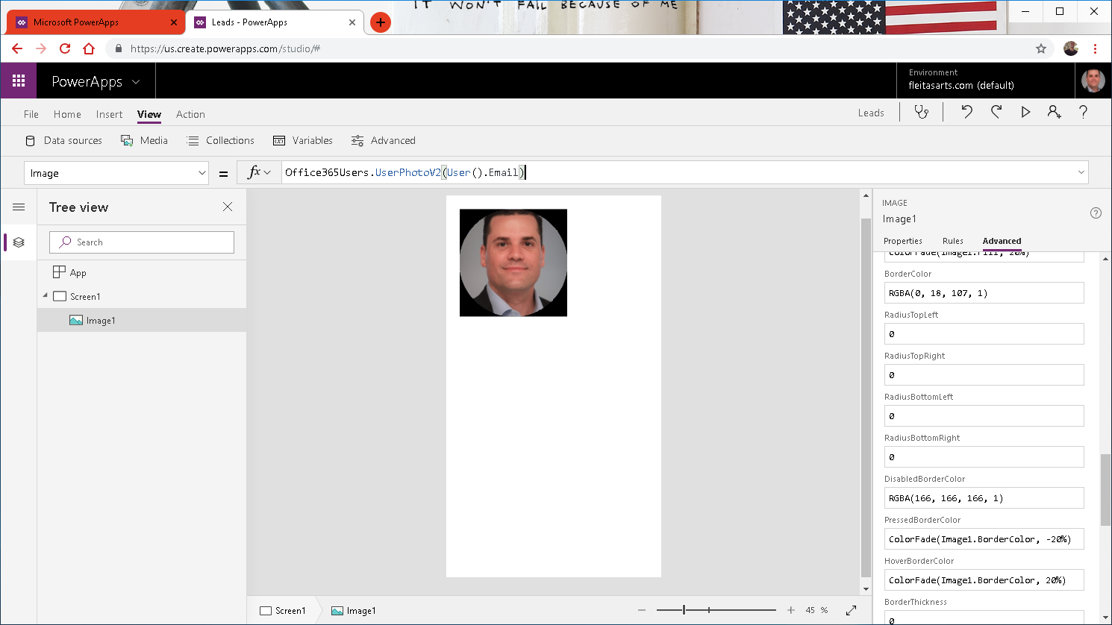

Slide 39
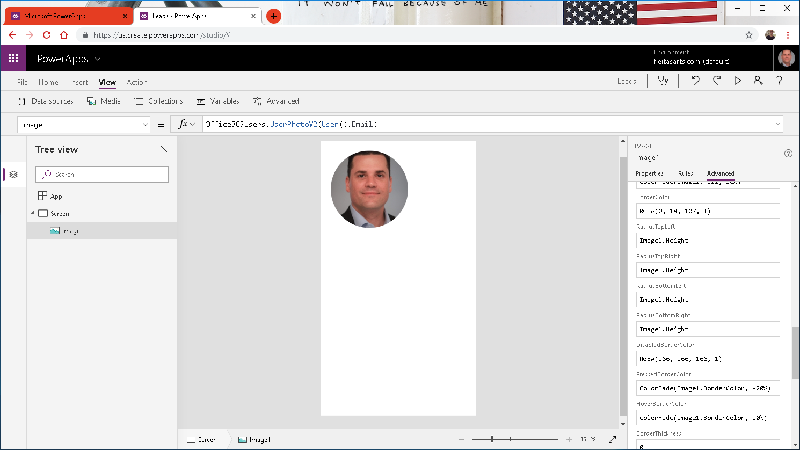

Slide 40
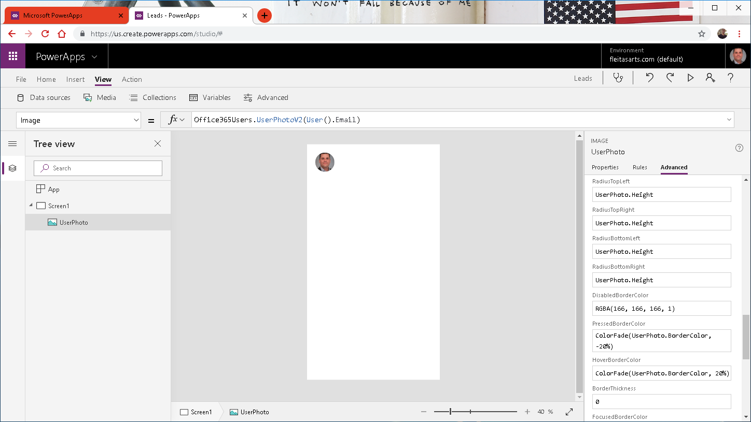

Slide 41
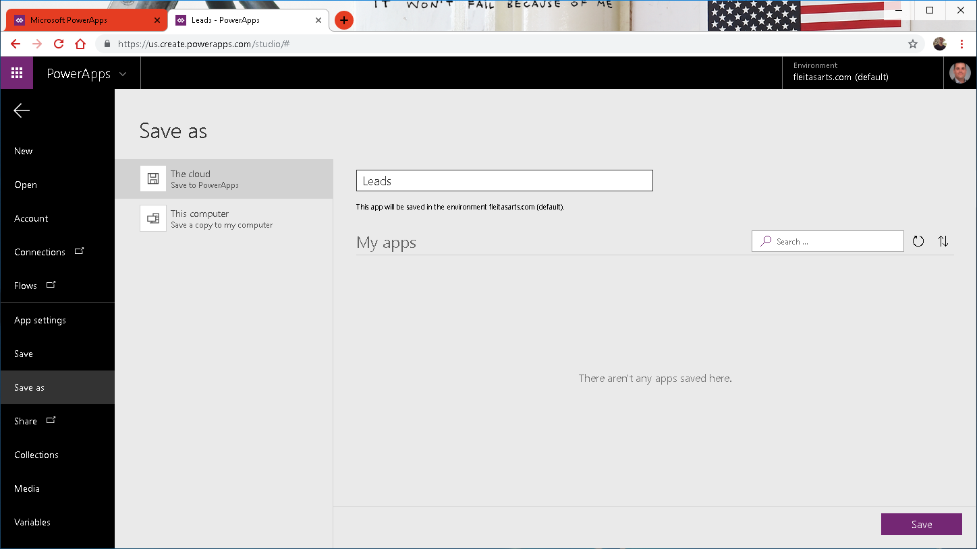


Slide 42
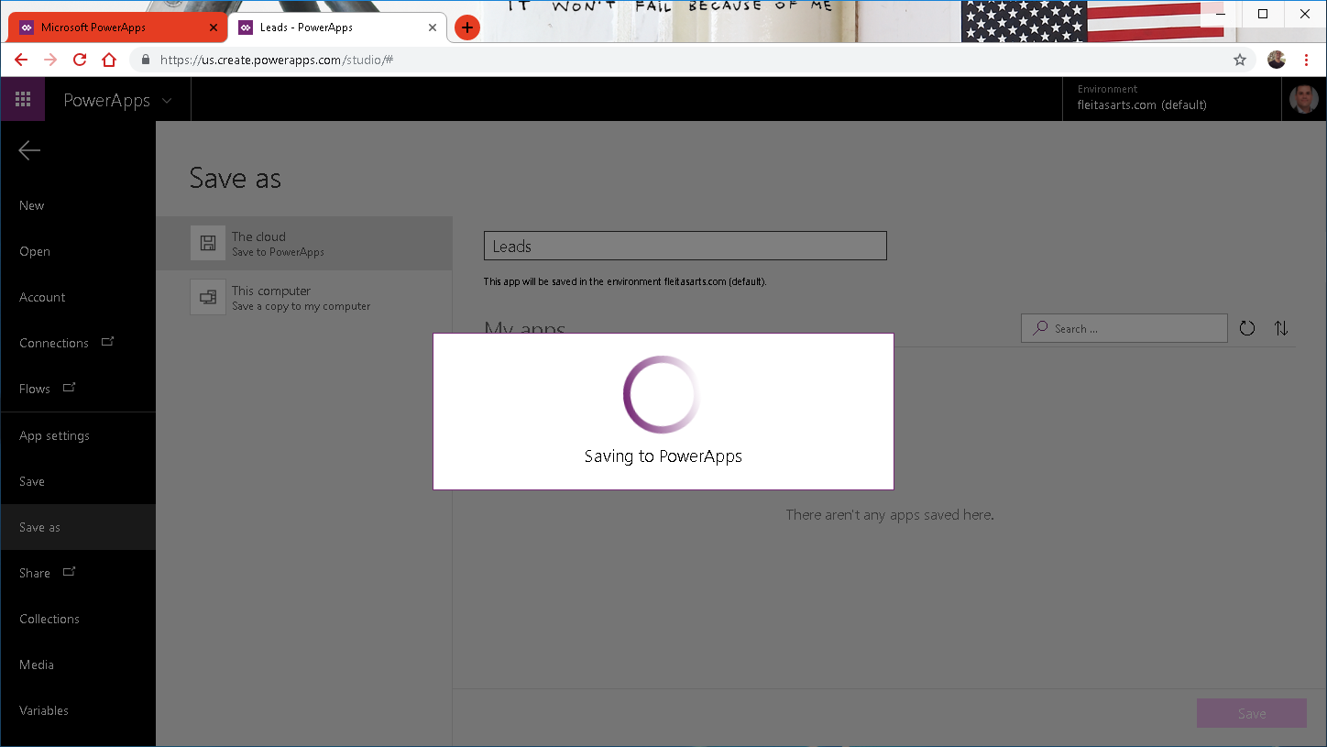

Slide 43
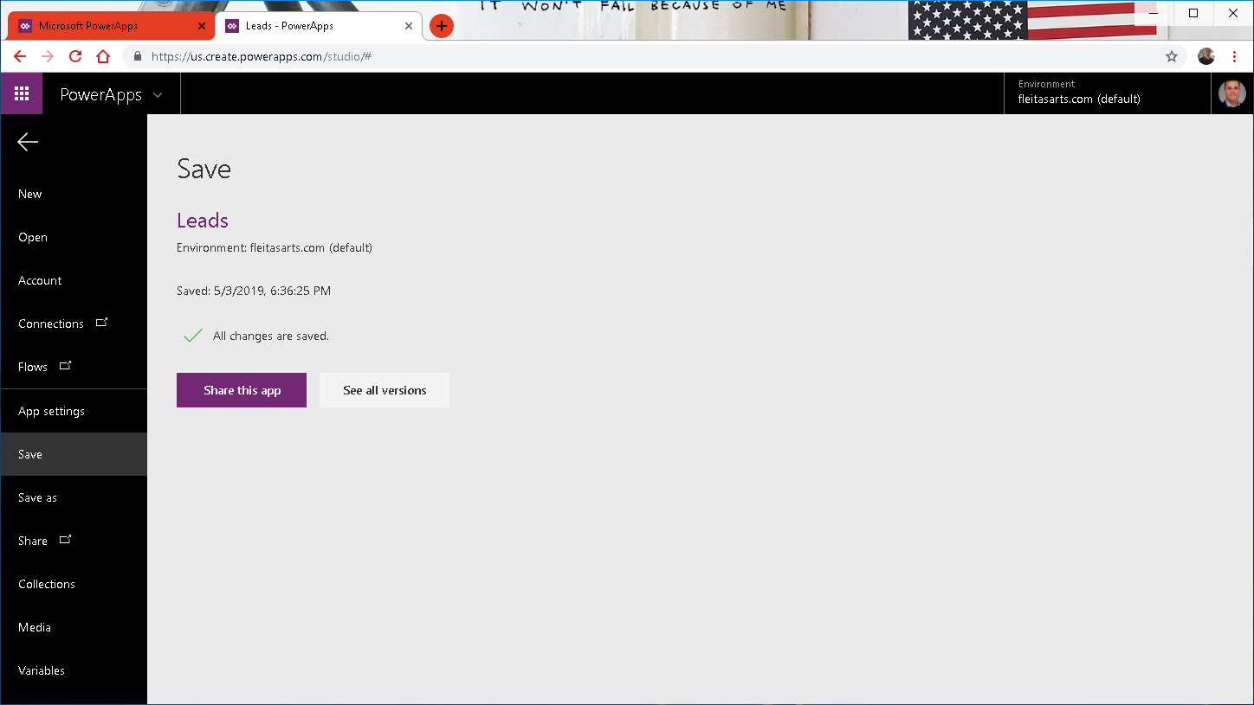

Slide 44
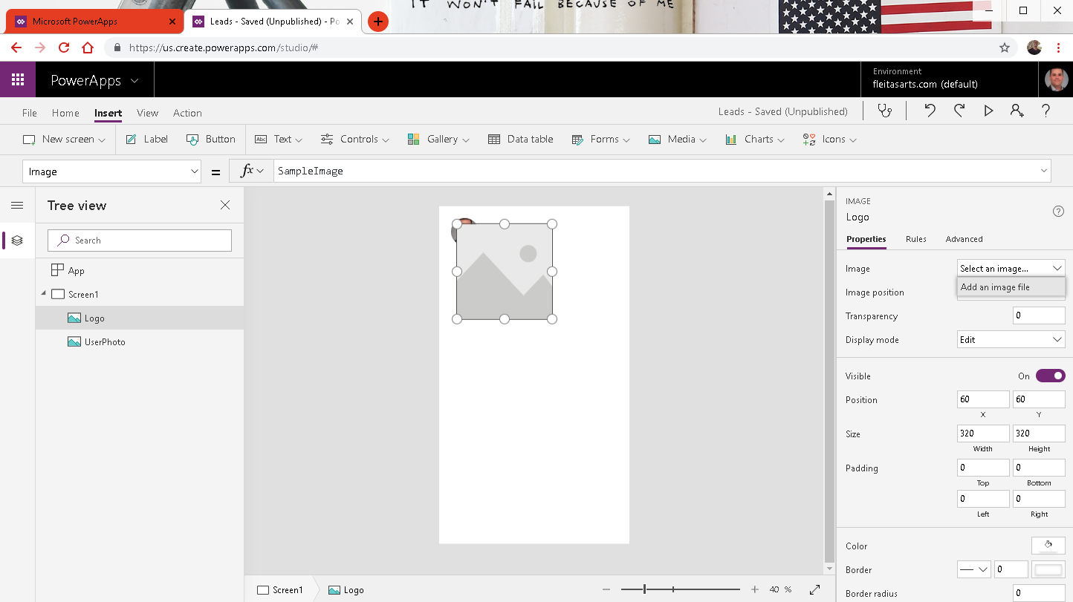
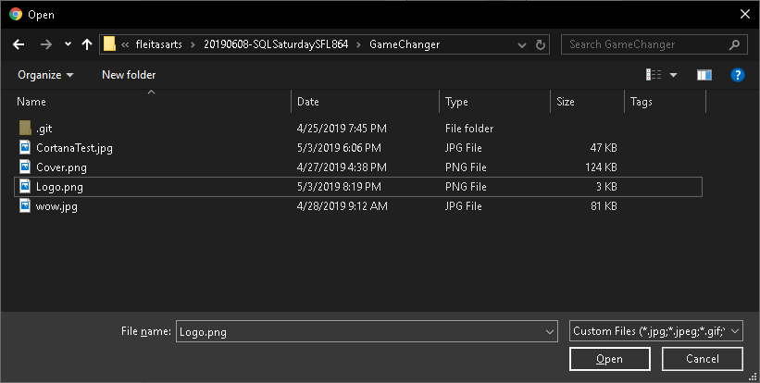

Slide 45
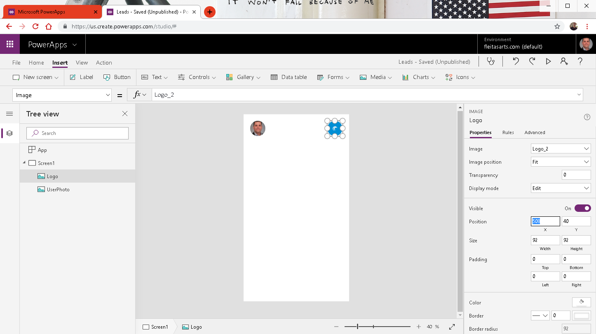

Slide 46
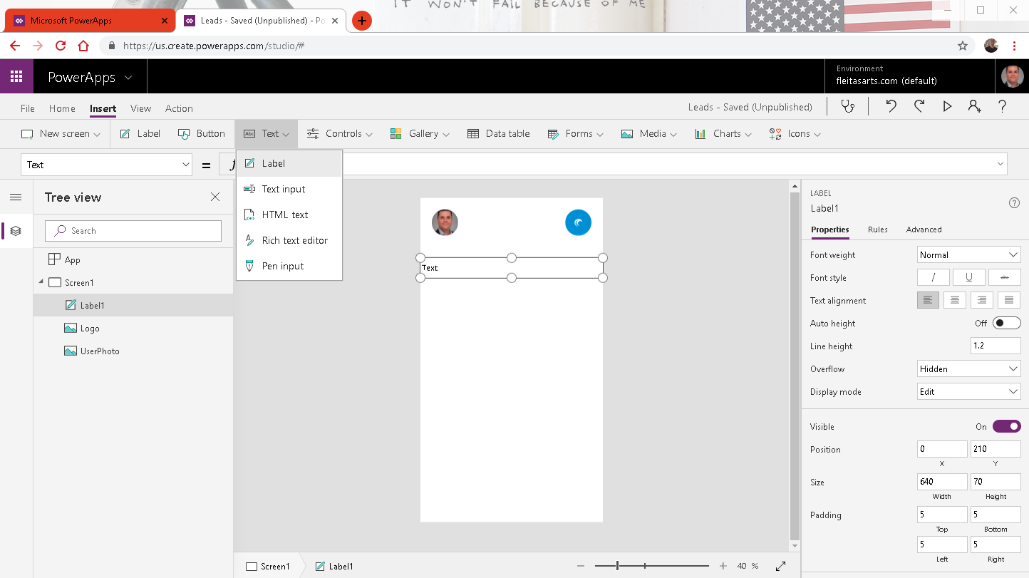
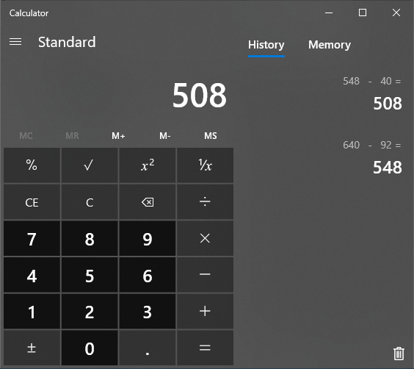

Slide 47
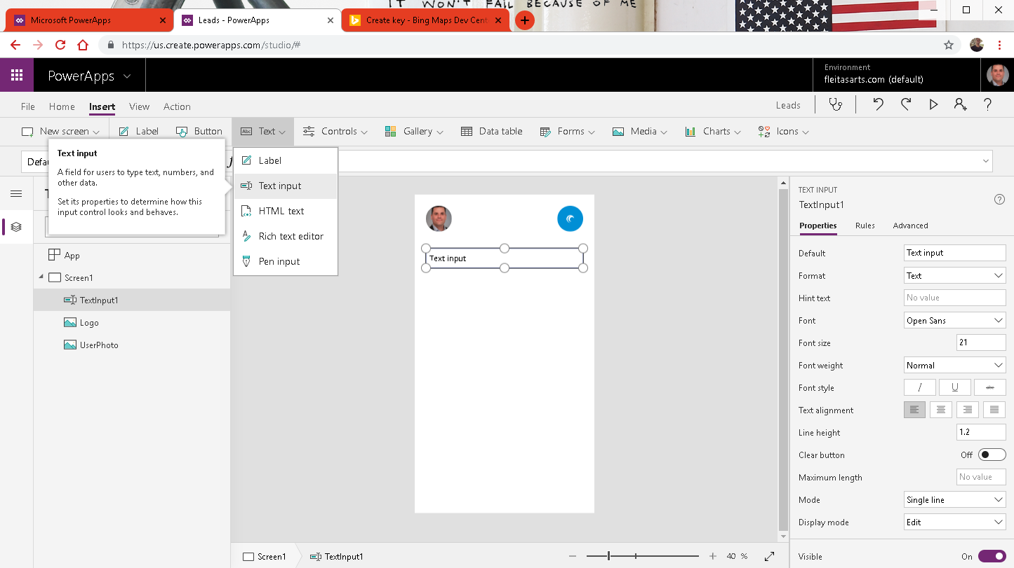

Slide 48
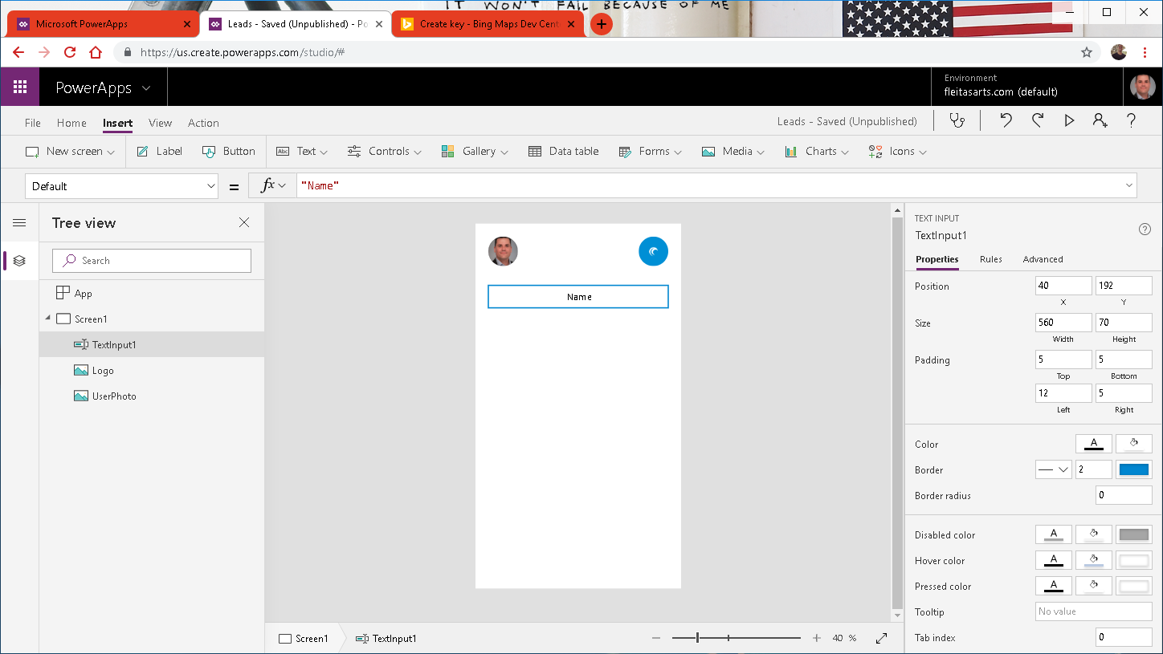
Notes:
Name, Email, Address

Slide 49


Slide 50
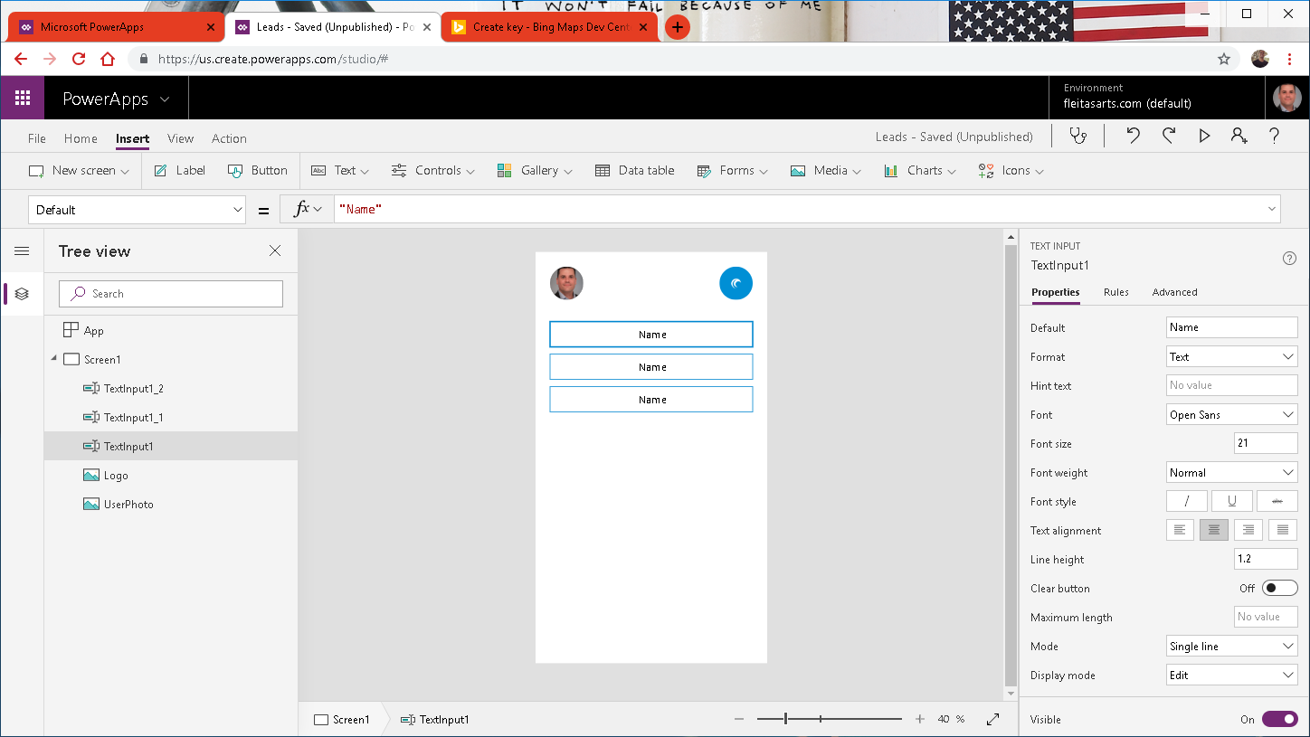

Slide 51
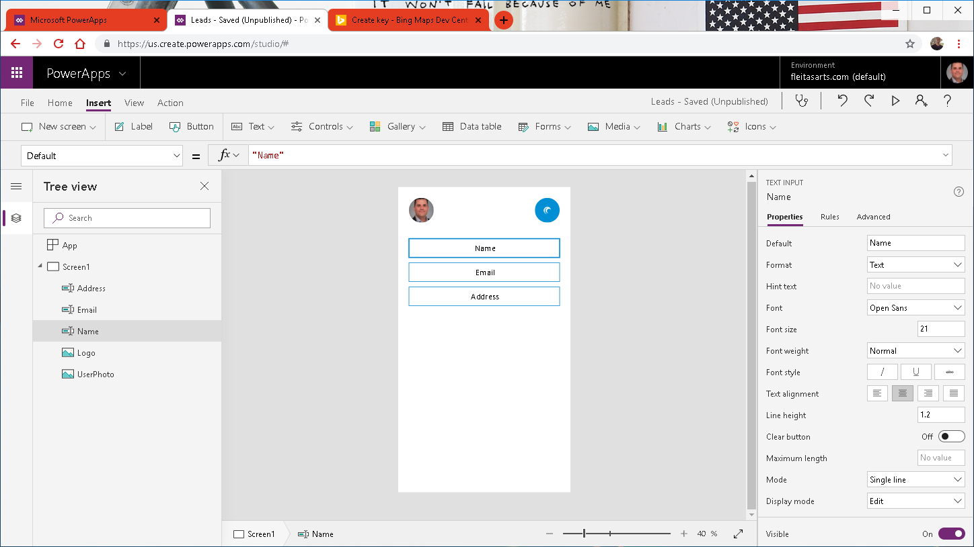

Slide 52
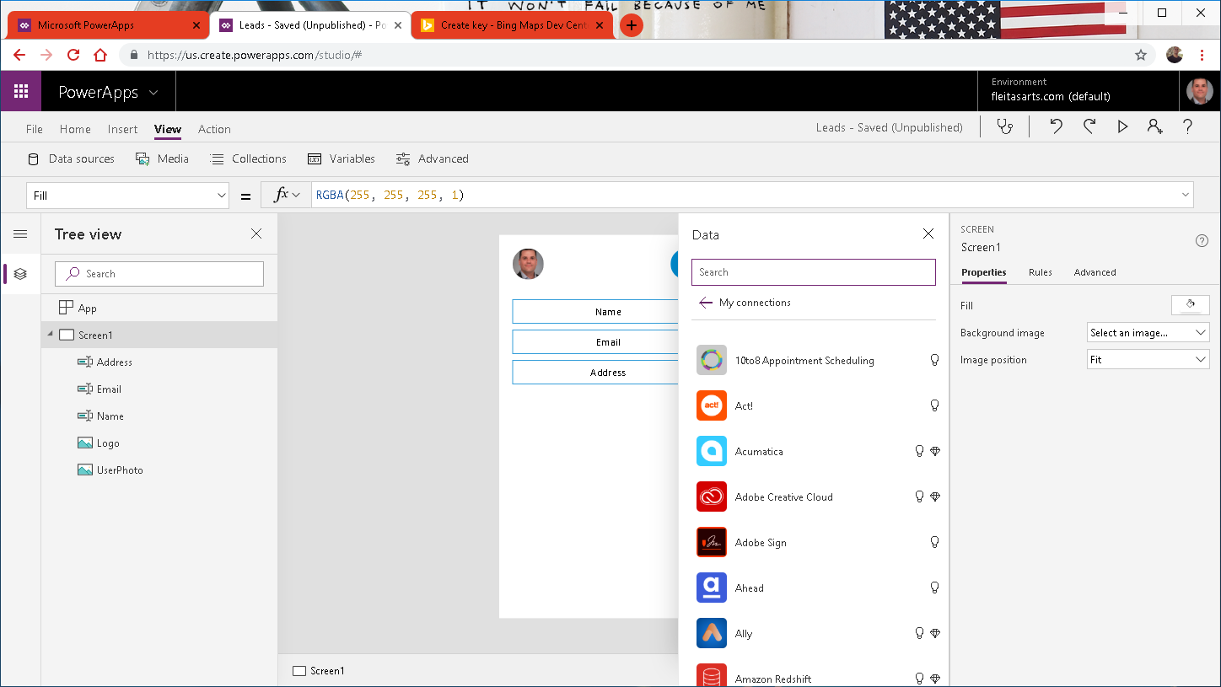

Slide 53
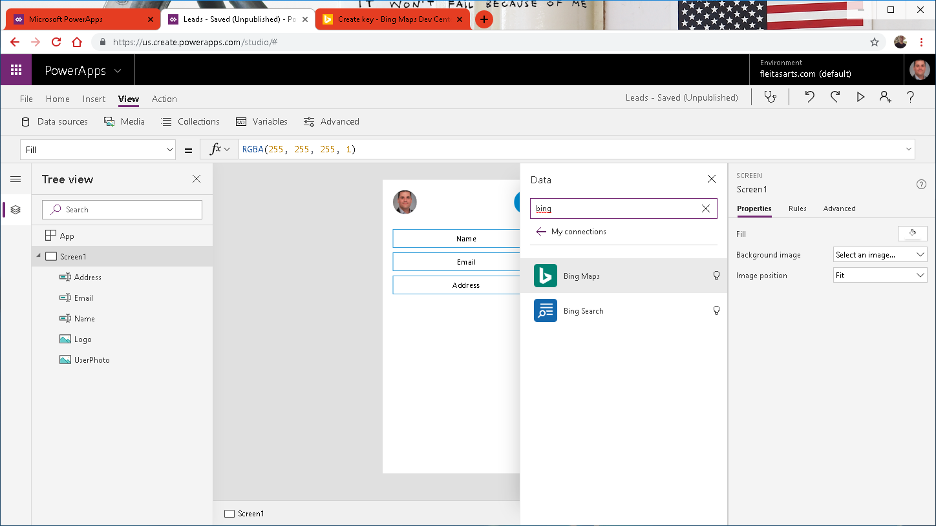
Notes:
Basic (50k/24hr, 125k/calendar yr)
Bing Maps can:
Create routes from A to B.
Give most efficient trucking routes.
Push pins on map locations.
Ref: https://docs.microsoft.com/en-us/bingmaps/getting-started/bing-maps-dev-center-help/getting-a-bing-maps-key

Slide 54
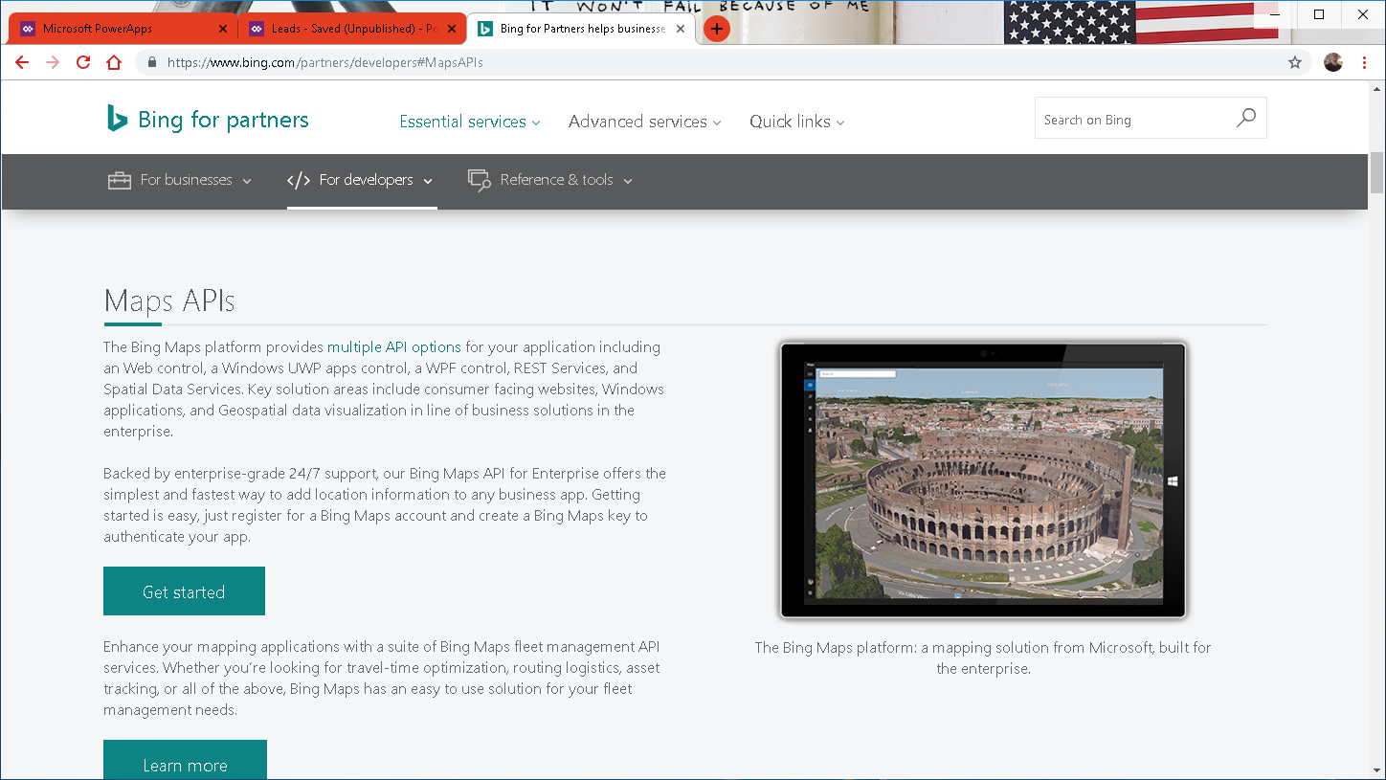
Notes:
Ref: https://docs.microsoft.com/en-us/bingmaps/getting-started/bing-maps-dev-center-help/getting-a-bing-maps-key

Slide 55
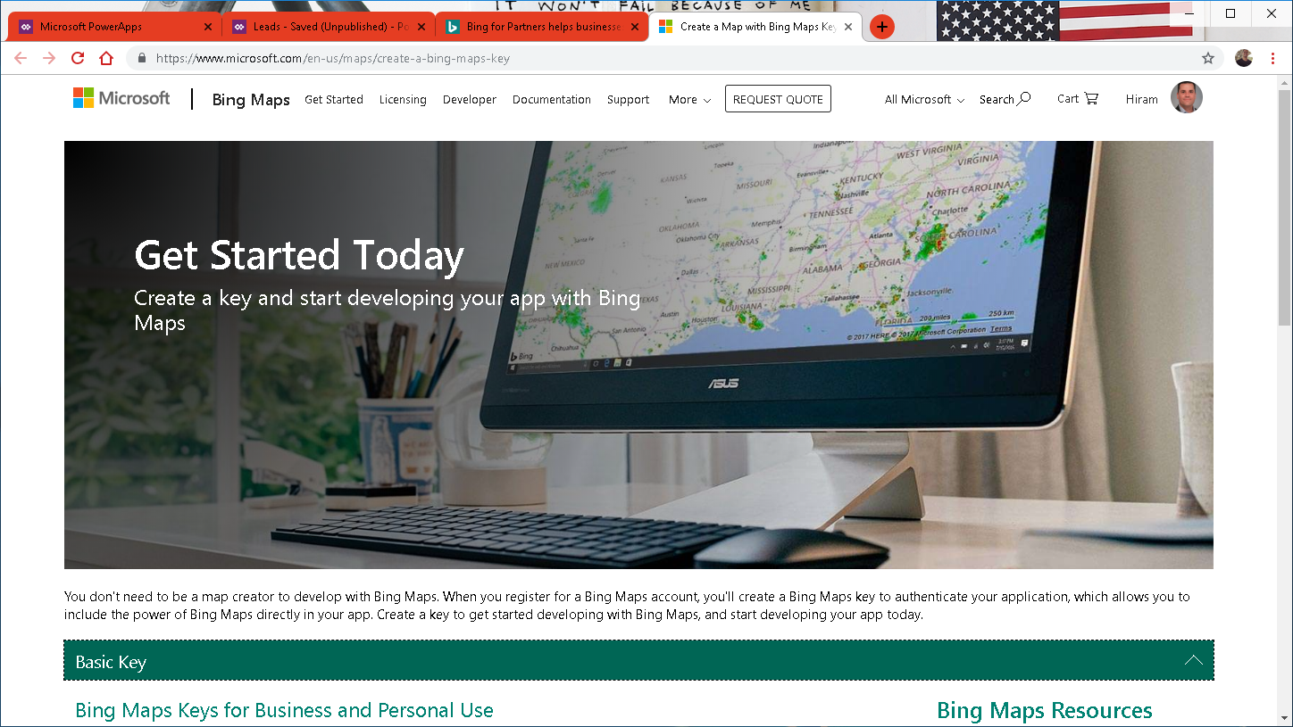
Notes:
Ref: https://docs.microsoft.com/en-us/bingmaps/getting-started/bing-maps-dev-center-help/getting-a-bing-maps-key

Slide 56
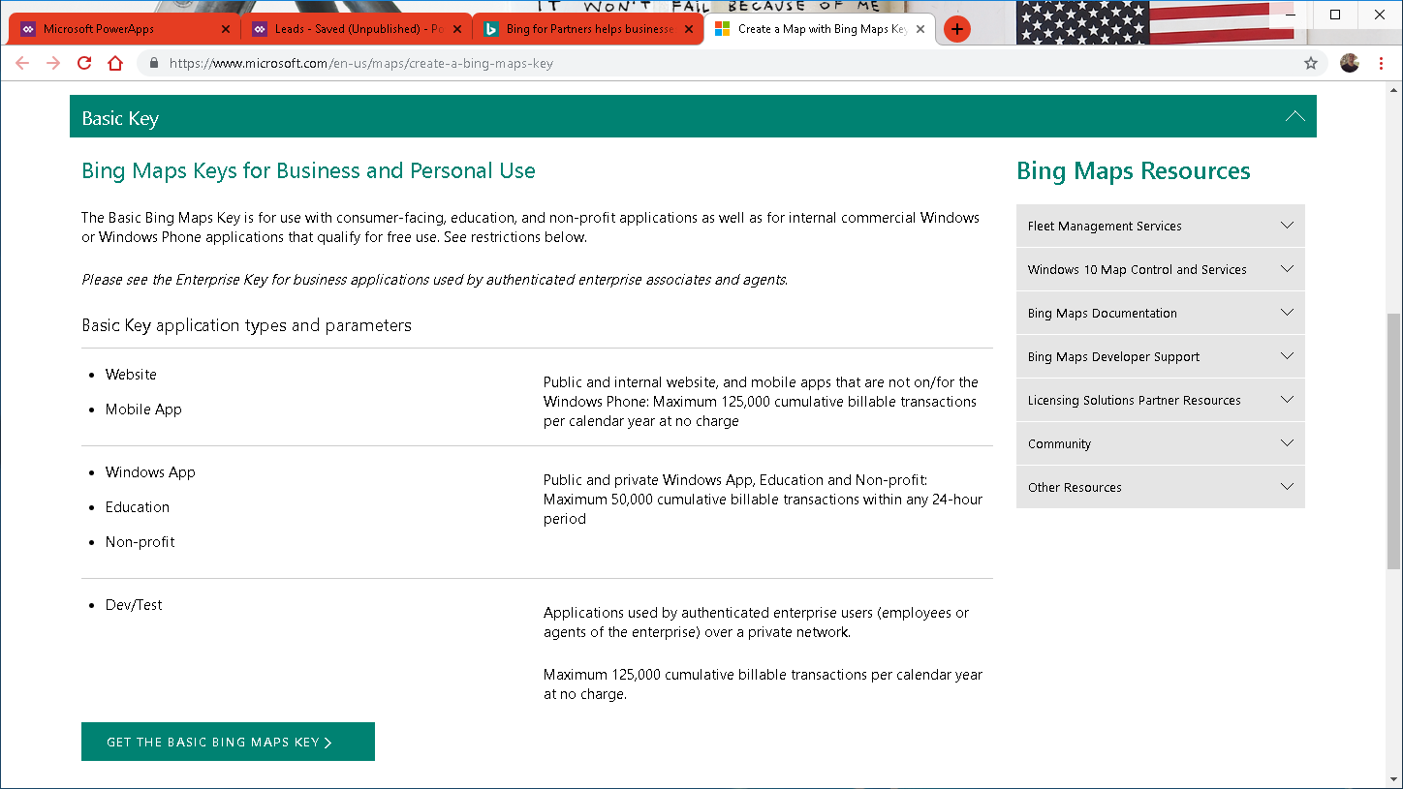
Notes:
Ref: https://docs.microsoft.com/en-us/bingmaps/getting-started/bing-maps-dev-center-help/getting-a-bing-maps-key

Slide 57

Notes:
Ref: https://docs.microsoft.com/en-us/bingmaps/getting-started/bing-maps-dev-center-help/getting-a-bing-maps-key

Slide 58

Notes:
Ref: https://docs.microsoft.com/en-us/bingmaps/getting-started/bing-maps-dev-center-help/getting-a-bing-maps-key

Slide 59

Notes:
Ref: https://docs.microsoft.com/en-us/bingmaps/getting-started/bing-maps-dev-center-help/getting-a-bing-maps-key

Slide 60

Notes:
Ref: https://docs.microsoft.com/en-us/bingmaps/getting-started/bing-maps-dev-center-help/getting-a-bing-maps-key

Slide 61

Notes:
Ref: https://docs.microsoft.com/en-us/bingmaps/getting-started/bing-maps-dev-center-help/getting-a-bing-maps-key

Slide 62

Notes:
Ref: https://docs.microsoft.com/en-us/bingmaps/getting-started/bing-maps-dev-center-help/getting-a-bing-maps-key

Slide 63

Notes:
Ref: https://docs.microsoft.com/en-us/bingmaps/getting-started/bing-maps-dev-center-help/getting-a-bing-maps-key

Slide 64

Notes:
Ref: https://docs.microsoft.com/en-us/bingmaps/getting-started/bing-maps-dev-center-help/getting-a-bing-maps-key

Slide 65

Notes:
Ref: https://docs.microsoft.com/en-us/bingmaps/getting-started/bing-maps-dev-center-help/getting-a-bing-maps-key

Slide 66

Notes:
Basic (50k/24hr, 125k/calendar yr)
Bing Maps can:
Create routes from A to B.
Give most efficient trucking routes.
Pushpins on map locations.
Ref: https://docs.microsoft.com/en-us/bingmaps/getting-started/bing-maps-dev-center-help/getting-a-bing-maps-key

Slide 67


Slide 68


Slide 69


Slide 70


Slide 71

Notes:
Ref: Integrating Bing Maps into PowerApps and Using the GPS: https://youtu.be/swpjfIyXCNA
Ref: https://docs.microsoft.com/en-us/bingmaps/rest-services/locations/find-a-location-by-address

Slide 72


Slide 73


Slide 74

Evaluate
Then true
Else false
Notes:
Pushpin: https://docs.microsoft.com/en-us/bingmaps/rest-services/common-parameters-and-types/pushpin-syntax-and-icon-styles

Slide 75

Notes:
Ref: Pushpin: https://docs.microsoft.com/en-us/bingmaps/rest-services/common-parameters-and-types/pushpin-syntax-and-icon-styles

Slide 76

Notes:
3 buttons

Slide 77


Slide 78

Notes:
Ref: Launch: https://docs.microsoft.com/en-us/powerapps/maker/canvas-apps/functions/function-param

Slide 79

Notes:
Ref: Launch: https://docs.microsoft.com/en-us/powerapps/maker/canvas-apps/functions/function-param

Slide 80


Slide 81


Slide 82


Slide 83

Notes:
Color RGBA(255,255,255,1)

Slide 84

Notes:
Fill Visual Background Color RGBA(0,0,0,0)

Slide 85


Slide 87


Slide 88


Slide 89


Slide 90

Notes:
Ref: https://uifabricicons.azurewebsites.net/

Slide 91


Slide 92


Slide 94


Slide 95


Slide 96

Notes:
Border: None
Color:

Slide 97


Slide 98


Slide 99


Slide 100


Slide 101

Notes:
I check for Email because it’s more unique vs Name or Address.

Slide 102

Notes:
The delete event could be for multiple addresses so the combination of 2 identifiers such as Name and Email get us there.

Slide 103


Slide 104

Notes:
Need to create 4 Flows:
LinkLead
DeleteLead
CheckLead
AddLead

Slide 105
Power Automate
three

Slide 106

Notes:
https://flow.microsoft.com

Slide 107



Slide 108


Slide 109


Slide 110


Slide 111

Notes:
Click Ask in PowerApps

Slide 112


Slide 113


Slide 114

body('Execute_stored_procedure')?['resultsets']
Notes:
body('Execute_stored_procedure')?['resultsets']

Slide 115

body('Execute_stored_procedure_(V2)')?['resultsets']
Notes:
body('Execute_stored_procedure')?['resultsets']

Slide 116


Slide 117


Slide 118


Slide 119


Slide 120



Slide 121


Slide 123


Slide 124


Slide 125


Slide 126


Slide 127


Slide 128


Slide 129


Slide 130


Slide 131


Slide 132


Slide 133


Slide 134


Slide 135


Slide 136


Slide 137


Slide 138

Notes:
Ref:https://flow.microsoft.com/en-us/blog/announcing-microsoft-flow-analytics/
Roadmap:
https://powerapps.microsoft.com/en-us/roadmap/
https://us.flow.microsoft.com/en-us/roadmap/
https://powerbi.microsoft.com/en-us/roadmap/

Slide 139
Data Gateway
four

Slide 140


Slide 141



Slide 143





Slide 144




Slide 145


Slide 147



Slide 149


Slide 150


Slide 151


Slide 152

Notes:
Install Gateway, at this point the Windows ACU prompt.

Slide 153

Notes:
Install Gateway, at this point the Windows ACU prompt again.

Slide 154


Slide 155


Slide 156

Notes:
THIS IS VERY IMPORTANT!!!!

Slide 157

Notes:
At this point the Gateway is installed and running.
See Service Settings, Diagnostics, Network and Connectors for more info.

Slide 158

Notes:
At this point the Gateway is installed and running.
See Service Settings, Diagnostics, Network and Connectors for more info.

Slide 159

Notes:
At this point the Gateway is installed and running.
See Service Settings, Diagnostics, Network and Connectors for more info.

Slide 160


Notes:
At this point the Gateway is installed and running.
See Service Settings, Diagnostics, Network and Connectors for more info.

Slide 161

Notes:
At this point the Gateway is installed and running.
See Service Settings, Diagnostics, Network and Connectors for more info.

Slide 162
Siri
five

Slide 163



Slide 164



Slide 165
six
Publish & Share Security Governance

Slide 166


Slide 167


Slide 168


Slide 169


Slide 170


Slide 171


Slide 172


Slide 173


Slide 174


Slide 175



Slide 176



Slide 177



Slide 178



Slide 179



Slide 180



Slide 181



Slide 182



Slide 183



Slide 184




Slide 185



Slide 186


Slide 187



Slide 189


Slide 190


Slide 191


Slide 192


Slide 193


Slide 194


Slide 195


Slide 196


Slide 197


Slide 198


Slide 199


Slide 200


Slide 201


Slide 202


Slide 203


Slide 204


Slide 205


Slide 206


Slide 207


Slide 208


Slide 209


Slide 210


Slide 211

Notes:
Microsoft Intune is a cloud-based service in the enterprise mobility management (EMM) space that helps enable your workforce to be productive while keeping your corporate data protected.
https://docs.microsoft.com/en-us/intune/what-is-intune

Slide 212
Forms – Ai builder
seven

Slide 213


Slide 214



Slide 215


Slide 216


Slide 218


Slide 219


Slide 221


Slide 222


Slide 223


Slide 224
Row-Level-Security (RLS)
eight

Slide 225



Slide 226


Slide 227


Slide 228






Slide 229



Slide 230





Slide 231


Slide 232


Slide 233


Slide 234


Slide 235


Slide 236


Slide 237


Slide 238


Slide 239


Slide 240


Slide 241
Approvals
nine

Slide 242


Slide 243


Slide 244


Slide 245


Slide 246


Slide 247


Slide 248


Slide 249


Slide 250


Slide 251


Slide 252
International Space Station
ten

Slide 253


Slide 254


Slide 255


Slide 256


Slide 257


Slide 258


Slide 259


Slide 260


Slide 261


Slide 262


Slide 263


Slide 264


Slide 265


Slide 266
aka.ms/TryPVA
five

Slide 267


End

Slide 268
Summary
Azure Data Studio Notebook
PowerApps
Microsoft Flow
Data Gateway
Siri
Publish & Share – Security

Slide 269
Summary
Ai Builder (Forms)
Row-Level-Security (RLS)
Approvals
ISS HTTP Web API
Power Virtual Agents

Slide 270
Resources
fleitasarts.com
github.com/hfleitas/charlotte918
Microsoft Learn
Pricing
Integrating Bing Maps with GPS
Scrolling Screen
Display User Profile Photo
Notes:
https://dba2o.wordpress.com/
https://docs.microsoft.com/learn/browse/?products=power-platform
https://docs.microsoft.com/power-platform/admin/pricing-billing-skus
https://youtu.be/swpjfIyXCNA
https://docs.microsoft.com/powerapps/maker/canvas-apps/add-scrolling-screen
https://youtu.be/rcrubFa8758
https://youtu.be/SaDEVOgOlYY
https://powerusers.microsoft.com/t5/General-Discussion/image-in-a-circle/m-p/9124#M4007
https://docs.microsoft.com/power-bi/service-cortana-intro
https://docs.microsoft.com/powerapps/maker/canvas-apps/open-and-run-a-sample-app
https://docs.microsoft.com/powerapps/maker/canvas-apps/webinars-listing
https://go.microsoft.com/fwlink/?LinkId=2005303&clcid=0x409
https://www.microsoft.com/en-us/businessapplicationssummit

Slide 271
Resources
Modal (Pop-up) Screen
Image Circle Crop
Siri Shortcuts
Sample canvas apps (Expense Report, Help Desk, Meeting Capture)
Webinar Listing
ROI Case Study

Slide 272

Community
Power BI
PowerApps
Microsoft Flow
Data Stories Gallery
Discuss, Connect, Feedback
Notes:
https://powerusers.microsoft.com/
Data Stories Gallery
Discuss, Connect, Feedback

Slide 273
Link to Eval:
bit.ly/CLT918
Your participation is very important.

Slide 274

Hiram Fleitas
Owner, Fleitas Arts
Thank You
@hiramfleitas
hiram@fleitasarts.com
fleitasarts.com
/hfleitas
hiramfleitas

